Slide 1
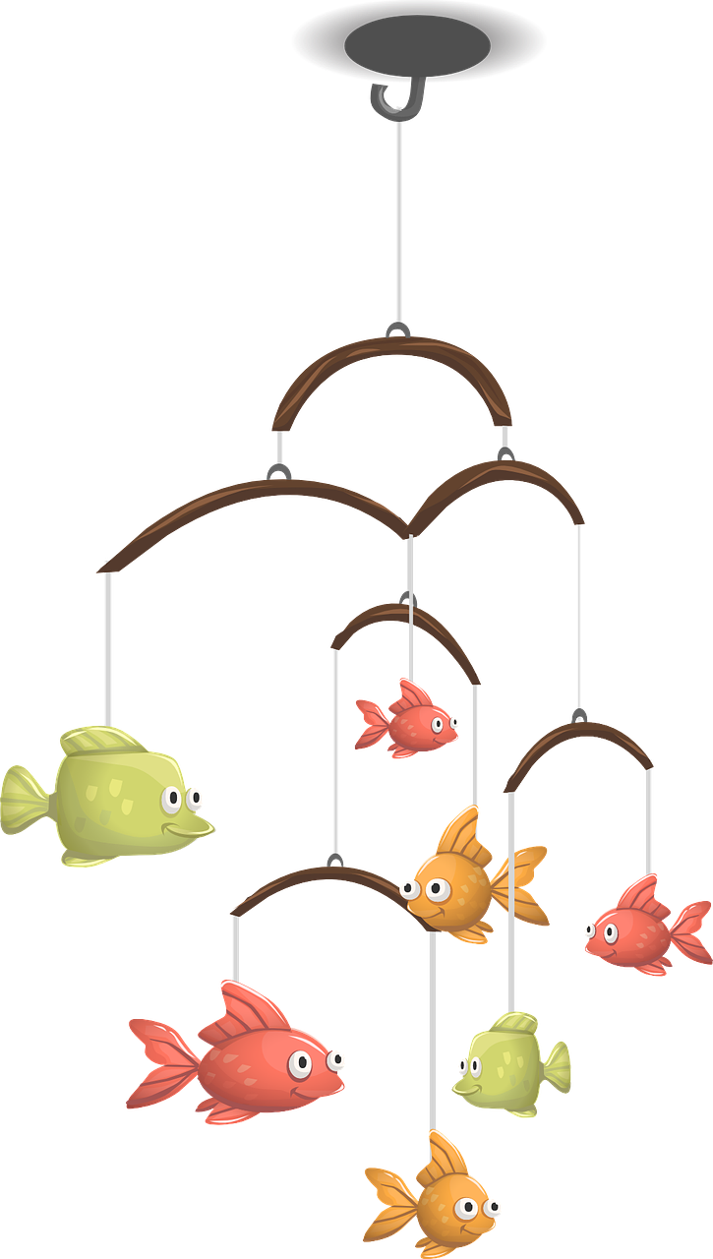
Prepare young people for the challenges of the future How can I rethink learning through ´design thinking´
ANITRA ARKKO
Principal, Suomen kristillinen yhteiskoulu / Finland 🇫🇮
Notes:
Welcome to the workshop
My name is ANITRA ARKKO and I am starting a new position as principal in FINLAND
That's why the content of my workshop represents more of the expertise that I have gathered in my previous work at the Lapland University of Applied Sciences, from where I am moving to the position of principal. I thought I would also activate you during the workshop, but I will introduce the topic first
In this workshop I present that
design thinking can be used when developing educational and learning practices and schools as well as ways to support learning
We represent Christian schools and therefore our thinking and practices are based on a Christian school environment but also Christian values
BUT first of all
Education is primarily based on the curriculum
but we have the opportunity to create tasks, activities, learning environments, processes with which we support learning and school operations
I'll take this as a starting point today

Slide 2
DESIGN THINKING
is about believing we
can make a difference, and having
an intentional process in order to get to new,
relevant solutions that create positive impact.
– IDEO
CURRICULUM
SPACES
PROCESSES AND TOOLS
SYSTEMS
What can I do with Design Thinking?
Notes:
“Design thinking is about believing we can make a difference,
and having an intentional process in order to get to new,
relevant solutions that create positive impact.”
says IDEO, which is well known Global design and innovation office.
It is generally understood that Design thinking is a MINDSET ––
And it has been used also as a process
IDEO also say that
“Design Thinking gives you faith in your
creative abilities and a process for transforming
difficult challenges into opportunities
for design.”

Slide 3
OFFER MORE THAN A SINGLE SKILL
(image: Pixabay)
Notes:
You perhaps know the story where the boy was hungry.
He said to his grandfather that "I want fish, I am hungry".
Grandpa said, “I'm not giving you a fish, I'm teaching you to fish
As teachers, we probably want to identify with this story, because we want to make sure that the students and young people learn to fish and navigate at sea – the sea of life
We want to offer more than one skill
- we want to offer young people skills and knowledge about navigating and fishing at sea
not only for themselves but also for their family and community

Slide 4
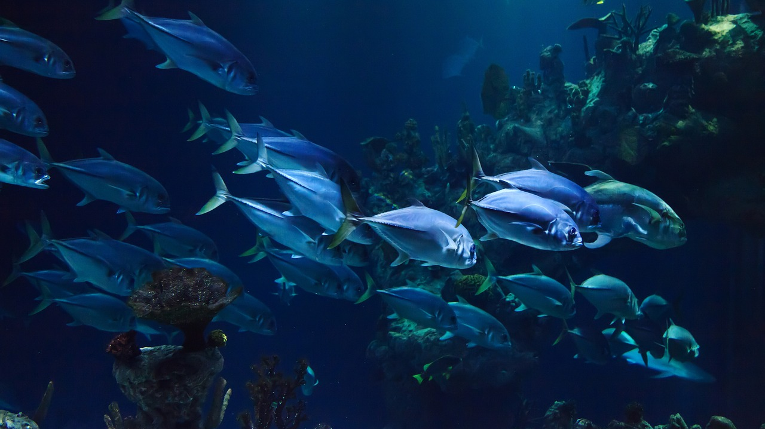
MORE SKILLS
&
LEARNING EXPERIENCES
(image: Pixabay)
Notes:
In this case I don't mean anything big but rather –
what kind of tasks can be used to support learning
Which learning environments support a meaningful learning experience
What kind of ways we can support the learning of future skills alongside other skills?
How can you redesign your classroom to better meet the needs of your students?
OR practices and activities while students learn new subjects and skills
metaphorically speaking:
the purpose of teaching and learning is not only to offer one fish, but above all to teach how “to fish” by utilizing different learning environments and school facilities

Slide 5
A CHALLENGING AND CONSTANTLY CHANGING WORLD?
(image: Pixabay)
Notes:
If for a moment, we jump to look at the world around us.
We see very clearly that the world is challenging and constantly changing.
As we know - life is like this now and the future will be same kind of
This sets demands to develop teaching and schools as well as practices that support learning which is needed at this time
We're not saying to young people that try to survive at sea.

Slide 6
ADDED VALUE FOR THE FUTURE
We can use "design thinking" when we design learning and practices in school, through which we bring added value to our target group.
Notes:
It is important for us to also think about learning environments, spaces and different ways to support learning and also different learners or atmosphere in the school - That "weather" around learning
“Design thinking” is one kind of key to ideate and design practices and give added value
We can use it when we design learning and practices at school.

Slide 7
REDESIGNING FOR WHAT
We can creatively develop our practices to meet the needs of today and the needs of the future, which is the whole mission of education.
(image: Pixabay)
Notes:
by using design thinking:
We can creatively develop our practices to meet the needs of today and the needs of the future, which is the whole mission of education.
For example by choosing suitable environments that support learning, we can offer learning experiences that also increase other life skills and abilities that are needed in society and in life.
I am sure we want to understand our ”target group”– students – and perhaps we need to understand also parents or other stakeholders
Why?
We want to offer young people value for life through education and we could offer learning for life in addition to individual skills.

Slide 8
FUTURE SKILLS
and meaningful learning experiences
(image: Pixabay)
Notes:
Christian schools already offer basic Christian values that serve as pillars for life
In addition, it would be important to keep in mind what kind of future young people will have after school.
I personally look at education holistically from preschool to working life because of my own background.
I myself have worked as a primary school, secondary school and high school teacher in the past, but for the last 15 years I have been teacher in university of applied sciences, when we have constantly looked at working life and its needs.
That is why we have developed the education and the methods what we have used, thinking about how the students will succeed in working life and in society after the UAS.
I see that whatever school level or whatever subject you represented, it is important to keep in mind what we are training young people for. We train them for society and working life. We want them to get good basics skills and have a good foundation for their own lives.
I believe that it is therefore important to keep in mind what other skills we can offer young people so that they are ready for life and also how we offer this. It happens rethinking education and learning practices

Slide 9
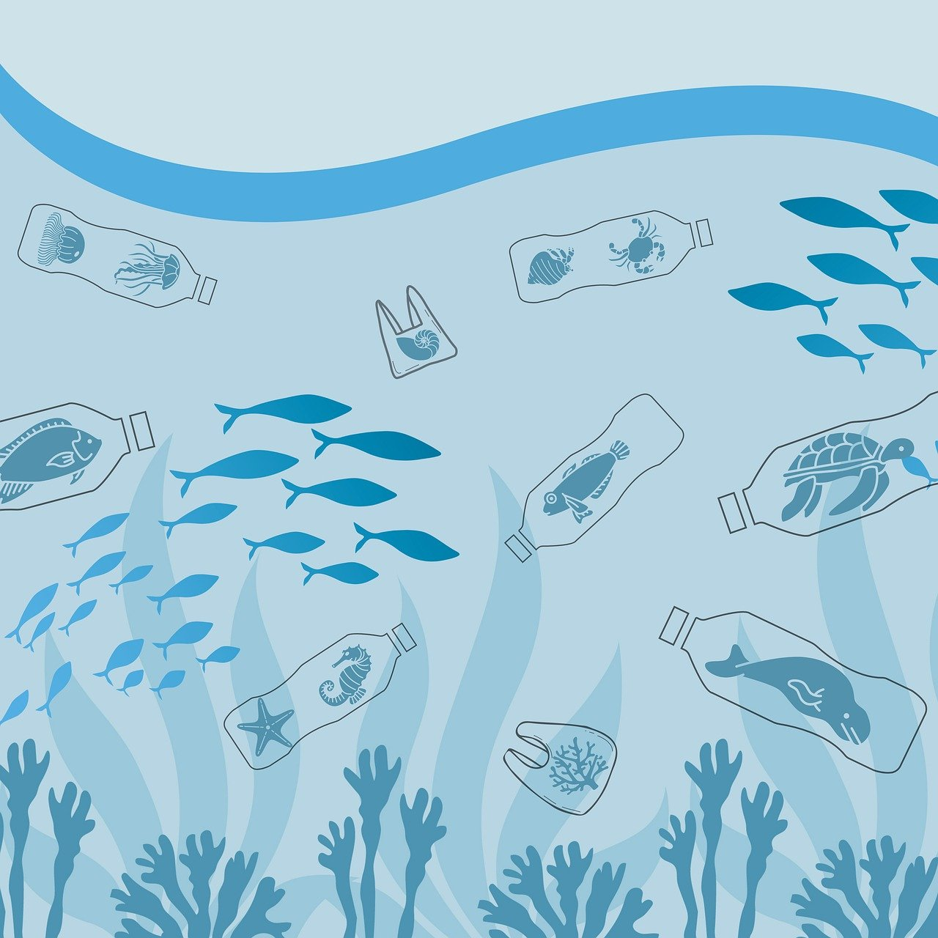
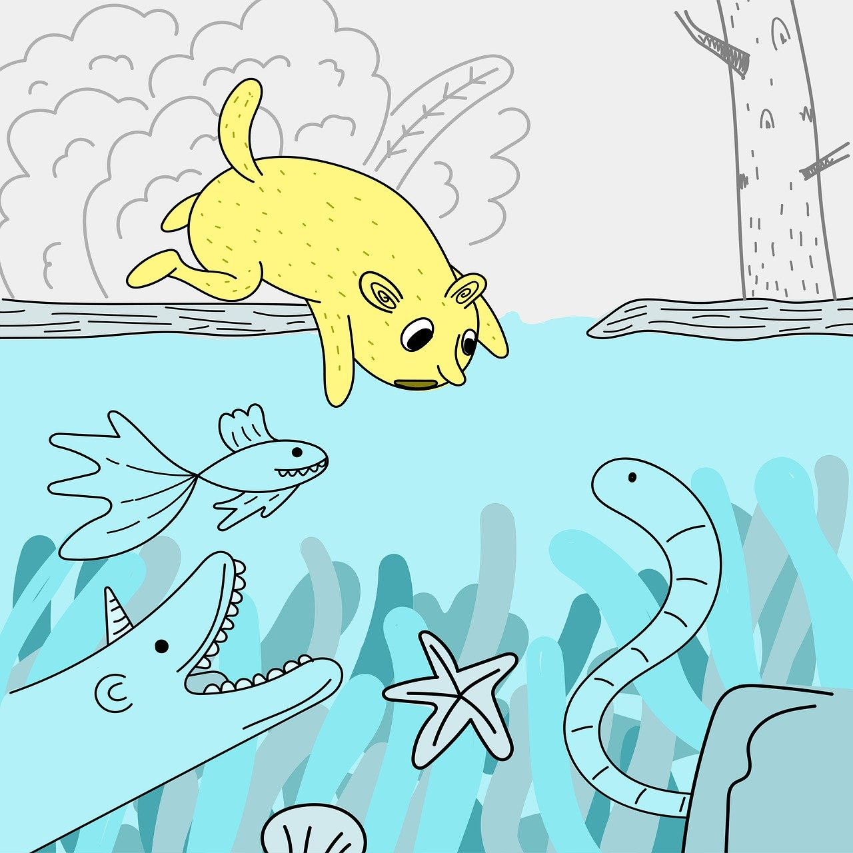
CREATIVE PROBLEM SOLVING
CRITICAL THINKING
COLLABORATION
RESILIENCE
EMPATHY
DIGITAL FLUENCY
(images: Pixabay)
Notes:
Here you can see skills that are currently important, but these are also important skills in the future, when we think about working life and society and what children and young people will face later in life.
For Example
Today, more than any other period in time, digital fluency is regarded as a necessary life skill for both children and adults. The potential of digital tools in early childhood learning has been recognized as helping to reinforce academic skills, as a way to communicate ideas and develop social skills, to support children to learn at their own pace, to learn how to learn and to make learning fun.
Think about one practical example of how one of these skills is included in the current teaching.
Strengthening innovative ability also leads to learning these skills – for example if learning is tied to a creative and authentic learning environment you support learning for life

Slide 10
THE DESIGN THINKING
PROCESS
EMPHATIZE
IDEATE
DEFINE
PROTOTYPE
TEST
Notes:
https://www.forumone.com/insights/blog/what-design-thinking-and-why-should-i-be-doing-it/
“Design Thinking” is a method commonly used by designers to solve problems.
The background of design thinking comes from the business world, but it can be utilized and applied in the development of schools and practices.
Design thinking is simple taking the toolkit that designers have using for decades and applying it to solving business problems – not just design problems but actually applying to solving business problems and it´s starts to look like this:
It´s about trying to understand your customers
And it´s about defining the problem space
Creativily coming up with solutions
Prototyping and testing those solutions
Seeing which decisions fit the design ruthlessly – what works and what doesn’t
And then moving forward
It also fits the challenges of school or education really well
when it is applied to the use of education to support different development purposes
So simply
Design thinking is a way of thinking
In design thinking process there are key to find USER centered SOLUTIONS

Slide 11
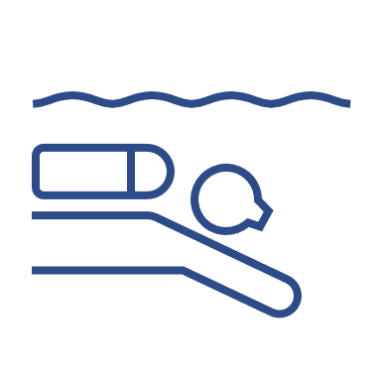
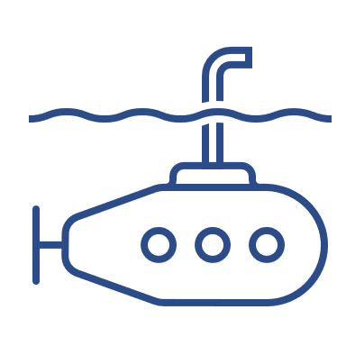
A TEACHER AS A DESIGNER
Notes:
The teacher can take on the role of a designer and actively develop content that supports learning or school practices.
This based on the service design which include also design thinking as a way to approach for the development and innovation practices.
Service design is a customer-oriented approach with a holistic view of development that includes the customer, business, service production and technology.
Service design is a versatile tool for developing services, business, customer experience,
user experience and strategies and also education practices.
Education is a public service.”

Slide 12
DESIGN THINKING
& CREATIVITY
for the development of learning practicies
DESIGN
(RE)THINKING
LEARNING
(image: Pixabay)
collaborate – create – understand user – test – iterate – develop – reflect – redesign
Notes:
Design thinking is open mindness to develop education or support learning and learning experiences using creative methods and iterative way of rapidly test and learn from it.
How can we choose or develop appropriate pedagogical ways to support the learning of these skills as part of other teaching?
In design thinking, we do it honestly, openly, experimentally By Using creative methods in cooperation with colleagues, students and other stakeholders
We can develope
>> spaces for learning
>> how we offer learning experiences
>> what learning environments we use
>> our school´s practices and processes
User-centric is one key thing in design thinking. We think about the target group and their needs.
Iterative testing takes place in real practical situations. Through it, we can learn and understand what works and produces added value for the target group (students, parents, other stakeholders and partners)
Also collaboration and co-design are the ways to design practices.

Slide 13
Rethink learning through ´design thinking´?
Notes:
(This Example can be found from Design thinking for educators https://www.ideo.com/post/design-thinking-for-educators )
Let´s take one example
Michael was a 2nd grade teacher in New York,
He realized that he never asked his students what would make them comfortable in the classroom.
He decided to talk directly with his students to figure out the best design for their environment.
Based on his students’ input, he was able to redesign his classroom to better address the needs and desires of his students.
For example He lowered the bulletin boards
that his students could actually see the content he’d spent hours putting together,
and he created a more comfortable semi-private space for the students to study by rethinking the student cubby space.
After that
His students were more engaged and moved more smoothly in the classroom space.
Now Michael consistently engages his students to help him more effectively shape their learning experience.

Slide 14
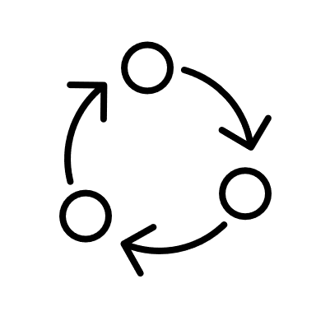
Design thinking is action
DISCOVERY
INTERPRETATION
IDEATION
EXPERIMENTATION
EVOLUTION
Notes:
Design thinking is action!
It creatively supports the development of the school environment
or classroom space or practicies
It can be a starting point that helps to understand what required development
Or it can be an approach to push development forward
It can be a way to take on a challenge and try new solutions
For example
Discovery builds a solid foundation for your ideas. Creating meaningful
solutions for students, parents, teachers, colleagues and administrators
begins with a deep understanding for their needs.
Discovery means opening up to new opportunities, and getting inspired to create new ideas.
With the right preparation, this can be eye-opening and will give you a good understanding of your design challenge.

Slide 15
TIPS – Use design thinking
Rethink learning through design thinking: methods, models, learning environments
Online learning, online learning environments and online collaboration
Tasks and activities
School environment and classrooms
Processes and operations
Marketing
Activities with other stakeholders and partners
Notes:
If I sum up
We can use design thinkin to help us to rethink learning and practicies and also these other things what I have sum up in the slide.
We could use “design mindset” – and design processes but also creative and innovative tools that support problem solving, for some challenging issue related to the school.
or
could you try some new way of producing a learning experiences?
or
could you, in collaboration with students, colleagues and other stakeholders, think about how to create a good atmosphere at school?
I am sure that
You already use a lot of good methods in your school and I believe that you have implemented these things in practice really fine
But now, in this workshop, it might be good to reflect and rethink them.
THINK
>> HOW teaching takes place in your school.
What are challenges?
What do the facilities look like, are they functional? What could be improved?
Can we offer more by considering something else? Methods, learning environments, online learning, tasks, activities, models, processes or even marketing of your school or excursions etc
How about working methods of teaching?
Could we rethink and develop them that they better support the skills to be learned and even the skills needed in the future?

Slide 16
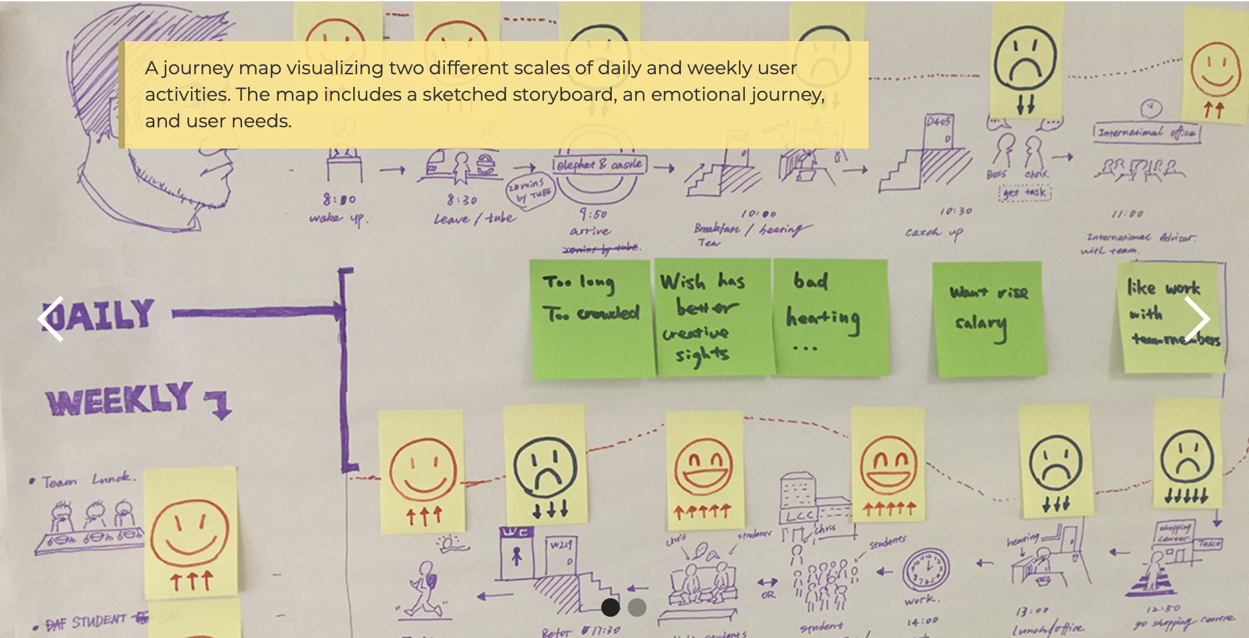
Examples
Journey map
step-by-step process https://www.thisisservicedesigndoing.com/methods
Notes:
This example comes from the e-book >> This is service design doing
https://www.thisisservicedesigndoing.com/methods
https://uploads-ssl.webflow.com/5989fc3322e8860001ac9a43/5a60fd63f18c0b0001044b61_lkaasd3463456543klhj23i4ho.pdf
Journey maps can visualize either existing
experiences (current-state journey maps) or new experiences that are planned but do not yet exist (future-state journey maps).
This could be used, for example, when planning a learning trip. Or you can use it together with your colleagues when planning the first week of the next school year for new students.
Journeymaps focus on human experiences,
illustrating the story of a specific actor as a sequence of steps. (Unlike service blueprints or business process maps)
The basic structure of a journey map consists of steps and stages defining the scale of the visualized experience. The scale can range
from a high-level journey map that shows the entire end-to-end experience to a very detailed journey map showing only a few minutes.

Slide 17
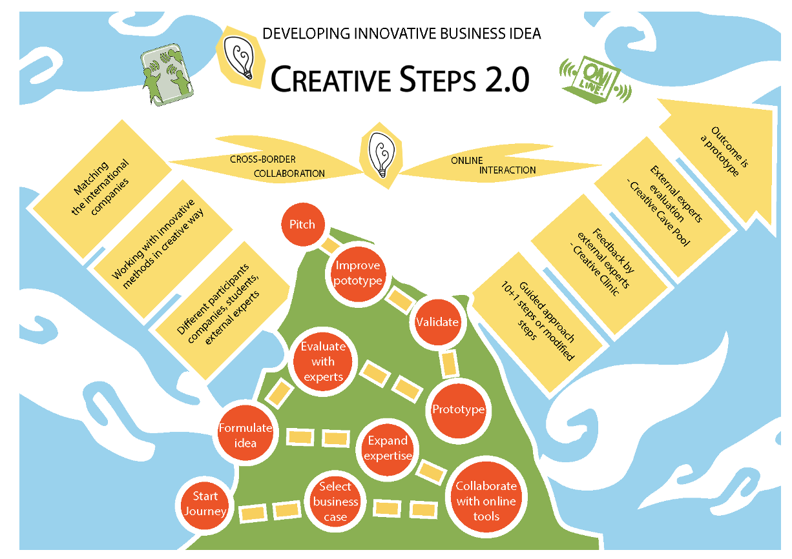
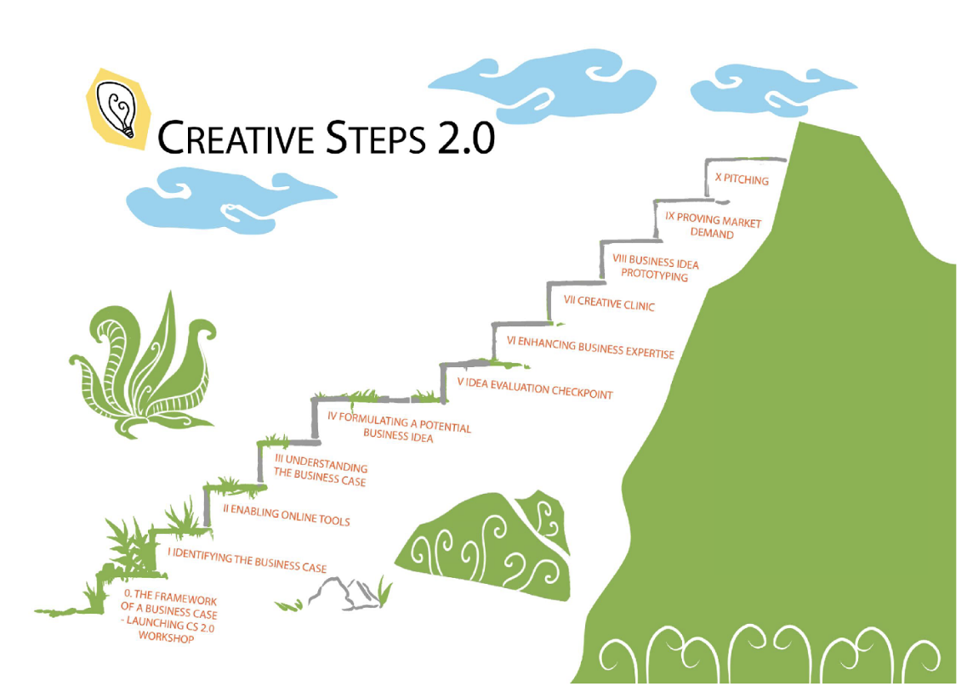
Design thinking &
co-design with stakeholders
STEP-BY-STEP METHOD
Creative and authentic learning and development environment
Pedagogical method
collaborative and creative online knowledge construction
Notes:
CREATIVE STEPS
For me, creative thinking is a mindset and way to act.
With its help, I have developed learning practices.
For example, I have design with collaboration other teachers this Creative Steps model that supports Innovation skills,
I used design thinking, and we used also co-design with stakeholders while we developed a creative and authentic learning and development environment
It also included a pedagogical method that support a collaborative and creative online knowledge construction structure.
But I have also design an assignments and a single task.

Slide 18
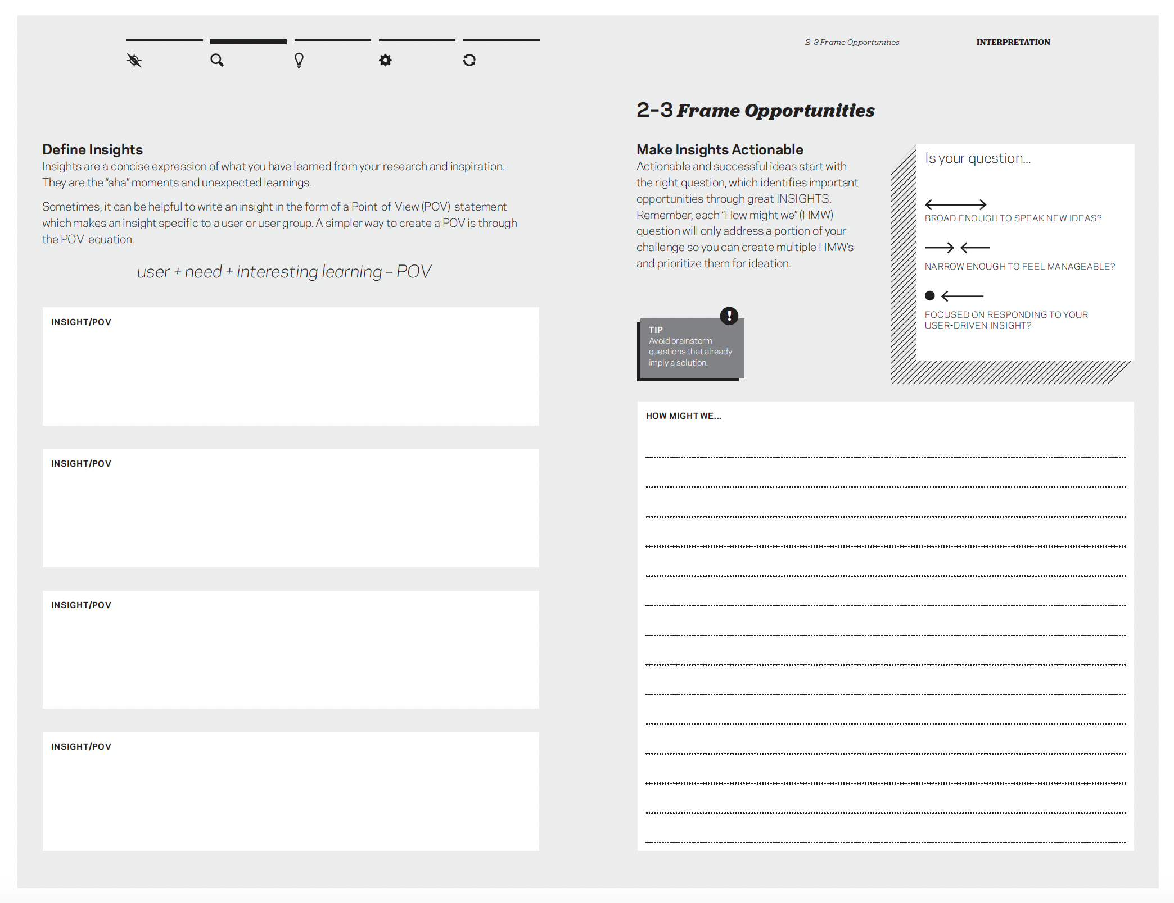
Frame opportunities and learn from good practices
Have "aha" moments
Design thinking for educators
IDEO
https://www.ideo.com/post/design-thinking-for-educators
Notes:
This is also one practical example from the book Design thinking for teachers
You can find more examples and tools on IDEO's website
You can Frame opportunities and learn from good practices – this could be call also benchmarking and gathering success stories
Have "aha" moments and inspirations from others

Slide 19
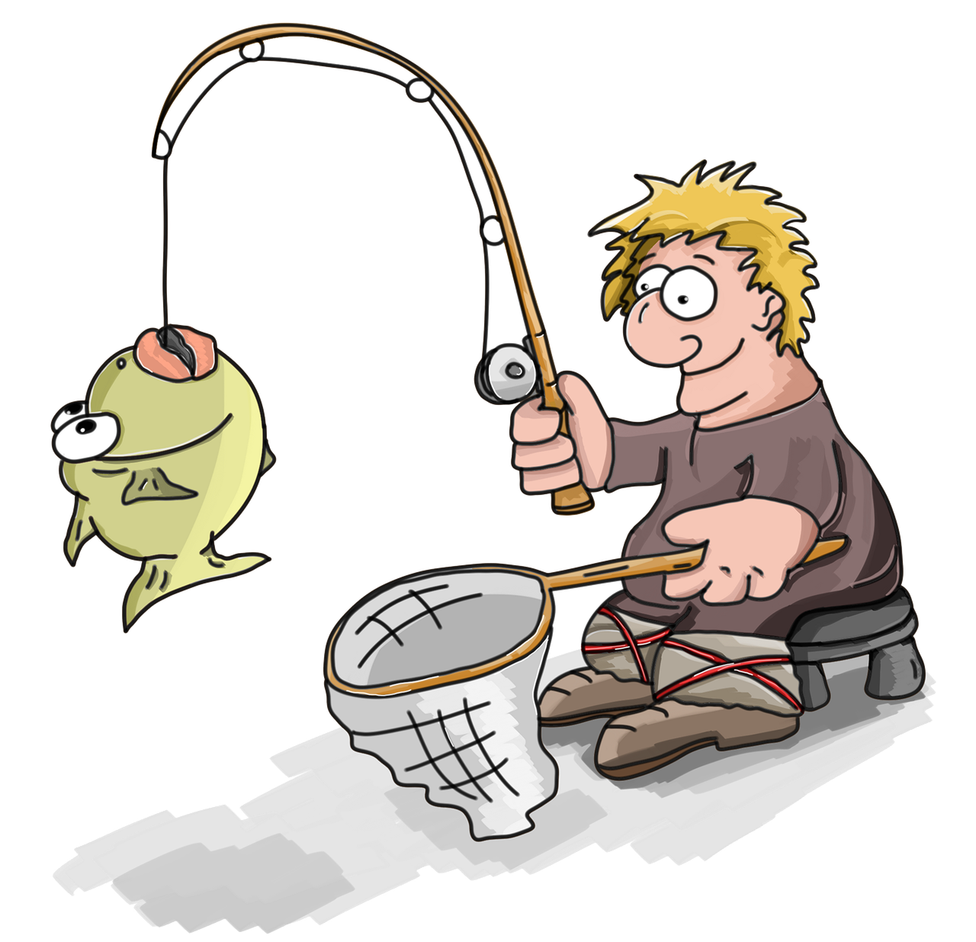
Notes:
So You can rethink even a single task.
Use "Design thinking" and create one task to be implemented in a new way

Slide 20
OR YOU COULD HAVE A
PROCESS HAMMER
Disney picture
Notes:
Or something stronger way to solve the challenges at your school
Then You could also use a process hammer
Beside design thinking, use various creative tools and innovative tools to find new solutions that add value to your students or your school
When you plan for the next school year, you can rethink even just one task, for example in collaboration with your colleague or with students
maybe you will get new ways to teach the subject
Now it is time to discuss and test one or two tools to rethink something…
or you can rethink some wider problem at school that requires something stronger way to solve the problem

Slide 21
DESIGN THINKING IS A PROCESS YOU CAN CHOOSE AND USE
DESIGN THINKING IS A MINDEST YOU CAN CHOOSE AND USE
(image: Pixabay)
Notes:
Design thinking as a mindset or process
I encourage you to take design thinking as a mindset
and it could be one way to rethink next school year.
and it is one way to rethink learning, learning environments, learning experiences, processes, facilities, marketing or just be a way of thinking that supports development (education, school, classroom)
[Creative task]
Through it you can think, discuss and share experiences and maybe get tips from others.

Slide 22
BRANCHES
represent teaching and learning
(which includes tasks, learning environments, learning models, methods, learning processes, learning materials, excursions etc.
FRAME YOUR DESIGN CHALLENGES
THE ROOTS
are the school and its operational facilities, processes, management, marketing and other partners or stakeholders that support the school
Notes:
[CREATIVE TASK]
Let's do it in groups – We´ll make groups soon
I´ll give task first so I hope you listen and then act
THIS picture REPRESENTS your school – What is YOUR SCHOOL ”BALANCE”
This tree represents school and education (learning and teaching and facilities around it all)
Branches represent teaching and learning (which includes tasks, learning environments, learning models, methods, learning processes, learning materials, excursions etc.
The roots are the school and its operational facilities, processes, management, marketing and other stakeholders that support the school
Think first by yourself
Think about the last school year
What do you think was one thing that worked or was a success?
write it briefly on a green/yellow post-it note
Think about next school year
What is the challenge that requires development or what change could be good in your own teaching or school?
write it briefly on a red/orange post-it note
Share a good experience or success that can also be a tip for someone else
After that, think together about practical challenges that require development. Are they related to roots or branches?
Share ideas with or thoughts with which you can tackle this challenge
Let's make groups of 3-4 people
Start by introducing who you are and what school and country you come from
If you look at this tree.
At the end
write down >> which challenge you want to develop more.
For that, find a way to develop it
Would it be together with students, teaching colleagues or together with other parties, e.g. parents, or another stakeholder group
Find out which creative method or tool supports this work
Take this post-it note with you – and ACT
As you remember – Design thinking is acting!

Slide 23
First introduce yourself:
who you are and what school and country you come from
Share a good experience or success that can also be a tip for someone else
Think about practical challenges that require development. Are they related to roots or branches?
Share ideas and thoughts HOW you can tackle these challenges
At the end WRITE a note for yourself – What needs to be develop more
Later, find the right people and creative tools to help you bring this idea to life
Design thinking is action!
Notes:
At the end
Write one task for yourself, which would be a task requiring development
what would it be that needs to be developed more – take that task with you and find right people and creative tools to help you for that

Slide 24
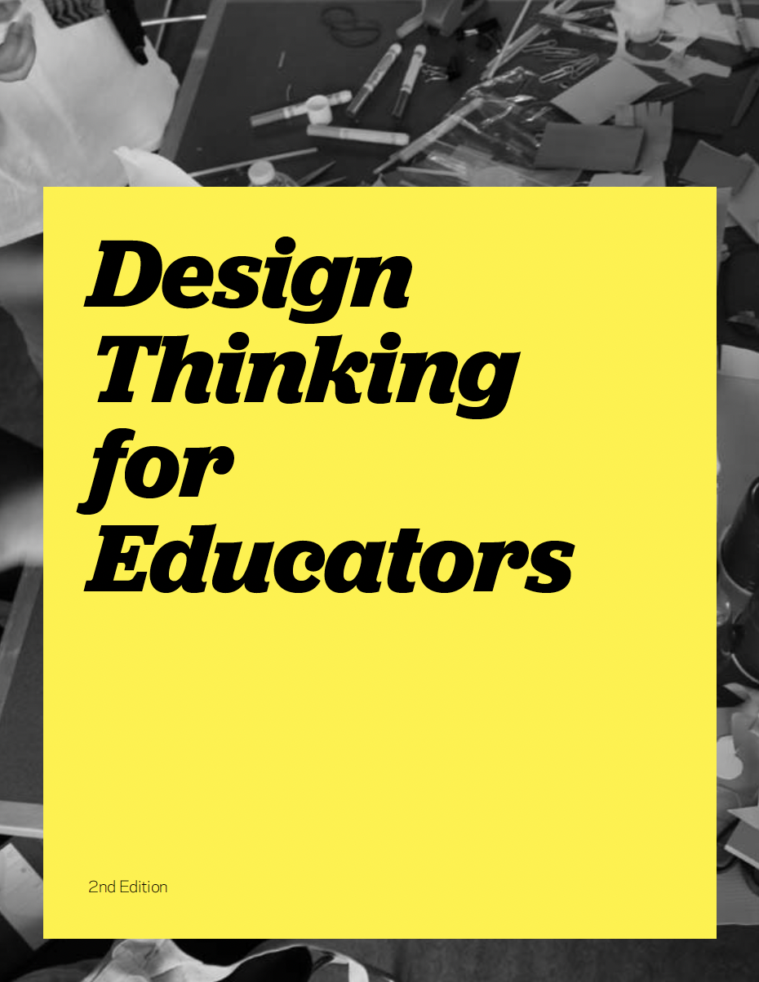
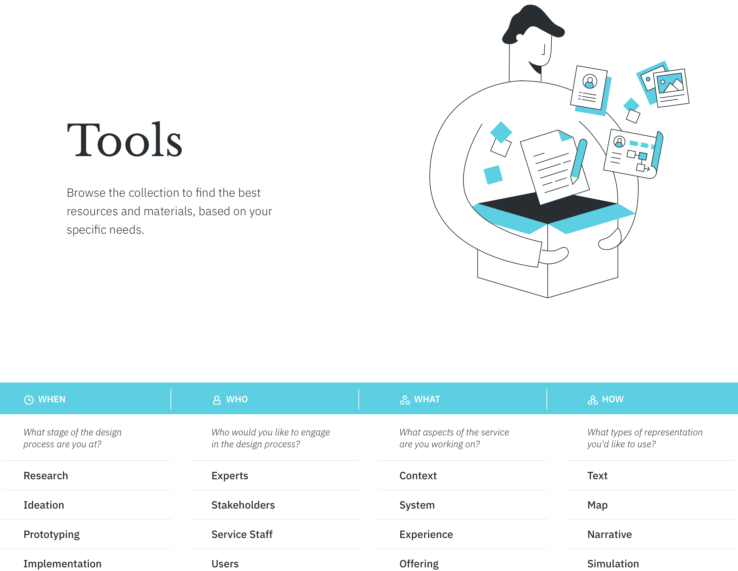
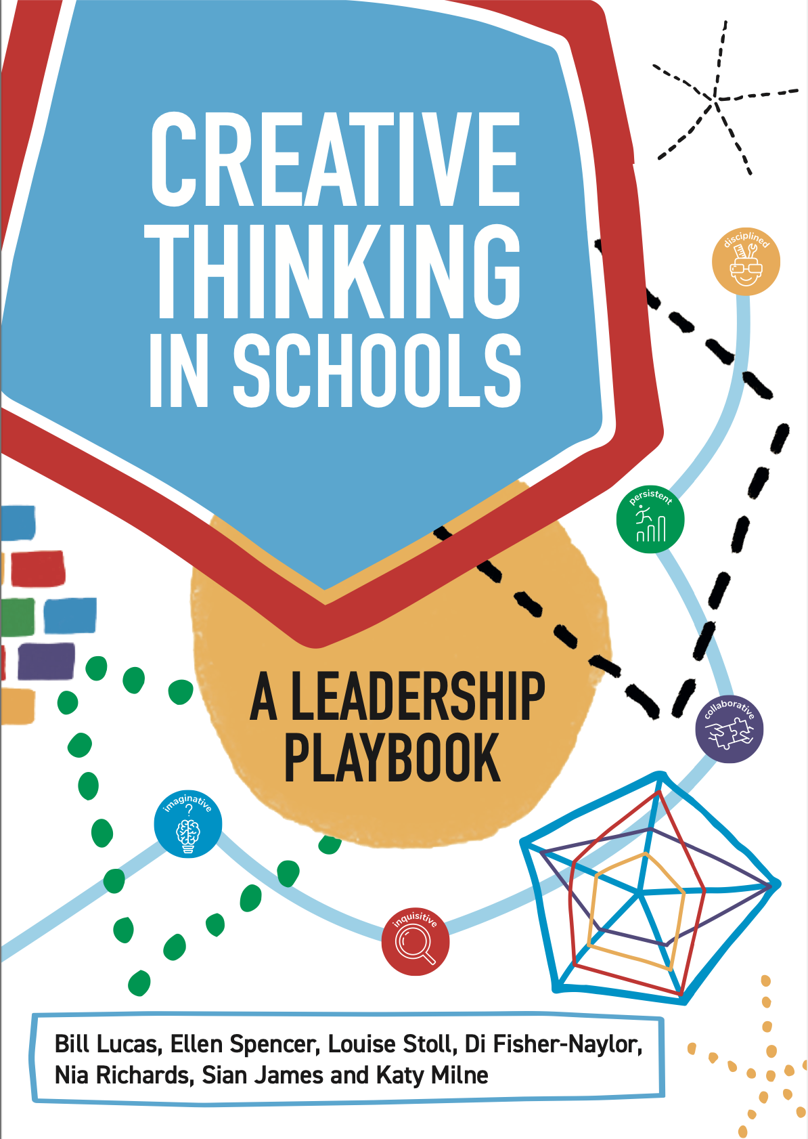
LEARN MORE AAAAA
Design thinking for educators https://www.ideo.com/post/design-thinking-for-educators
“The Co-Designing Schools Toolkit helps build the capacity of school communities to set and pursue equity aspirations, so that every student is future-ready, no matter who they are, where they live, or how they learn.” https://www.codesigningschools.com
Service Design tools https://servicedesigntools.org/tools https://www.designkit.org/methods.html
Here's something extra for you if you're interested in creativity in your school:
Creative Thinking in Schools focuses on how school leaders can create capacity among their staff to embed creative thinking in every aspect of school life. https://www.crownhouse.co.uk/assets/look-inside/9781785836848.pdf
Notes:
Practical tips for you
Design thinking for educators – book
IDEO and Teachers at Riverdale Country gives practical tips, methods and processes how to tacle complex challenges in schools. Design Thinking helps to get to the next step and it can impact the world of education. School can start to use design process to address challenges in classrooms and schools.
https://www.ideo.com/post/design-thinking-for-educators
Creative Thinking in Schools focuses on how school leaders can create capacity among their staff to embed creative thinking in every aspect of school life. It offers a framework for improving creative thinking based on the widely used Five Creative Habits model developed by the Centre for Real-World Learning. The framework focuses on developing learners who are inquisitive, persistent, collaborative, disciplined and imaginative.
https://www.crownhouse.co.uk/assets/look-inside/9781785836848.pdf
Service Design tools
https://servicedesigntools.org/tools
https://www.creativityexchange.org.uk/ideas-hub/teaching-creative-thinking-developing-learners-who-generate-ideas-and-can-think-critically
https://www.perlego.com/book/568139/teaching-creative-thinking-developing-learners-who-generate-ideas-and-can-think-critically-pdf?utm_source=google&utm_medium=cpc&campaignid=19806006872&adgroupid=146299647265&gclid=CjwKCAjw5MOlBhBTEiwAAJ8e1vI-CFvc59NyLF7StrH2kq3Rvw1i5uD_BWSrZb7VRunzSC5OcqqGFRoCmxAQAvD_BwE

Slide 25
The Double Diamond
“Design Council’s presented Double Diamond, a design process to designers and non-designers alike. The two diamonds represent a process of exploring an issue more widely or deeply (divergent thinking) and then taking focused action (convergent thinking). “
Develope
Deliver
Discovery
Deifine
Source: https://www.designcouncil.org.uk/our-resources/the-double-diamond/
Notes:
The Double Diamond is well known and a visual representation of the design and innovation process. It’s a simple way to describe the steps taken in any design and innovation project.
The "double diamond" is well known and widely used as a work method in the development process in the service design
When "Double diamond" is a process, various creative methods and tools used in service design are added to support the need for development
the divergent and convergent phases vary during the development process
DISCOVER
The first diamond helps people understand, rather than simply assume, what the problem is. It involves speaking to and spending time with people who are affected by the issues.
DEFINE
The insight gathered from the discovery phase can help you to define the challenge in a different way.
DEVELOP
The second diamond encourages people to give different answers to the clearly defined problem, seeking inspiration from elsewhere and co-designing with a range of different people.
DELIVER
Delivery involves testing out different solutions at small-scale, rejecting those that will not work and improving the ones that will.

Slide 26
Something extra Lessons from Finnish education
For those interested in Finnish education
Pasi Sahlberg talks about it in these videos
'What if Finland's Great Teachers Taught in Your Schools?' | Pasi Sahlberg
https://youtu.be/ERvh0hZ6uP8 [16:54]
Pasi Sahlberg | Finnish Lessons: What the World Can Learn from Educational Change in Finland [1:28:00]
https://youtu.be/WeMM-hL0KFY
Excellence & Equity - How To Make Change Happen At Scale? | Pasi Sahlberg | HundrED Summit 2018
https://youtu.be/UKZzGRFzrI4

Slide 27
Contact:
Anitra Arkko
Suomen kristillinen yhteiskoulu, Finland
anitra.arkko@skyk.fi

