Slide 1

School Bullying: A few ideas for prevention

Slide 2
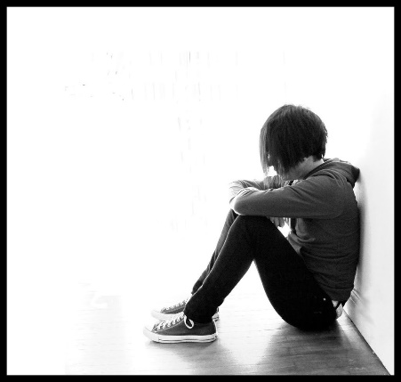
“I hated having to go to school. It took a lot of energy to muster up the courage to go. I did have a loyal friend in Shelly and having her support meant a lot to me. I didn't feel quite so alone. For the most part however, I felt unprotected and like I was being fed to the wolves. It was intimidating.” [NM]

Slide 3

Effects of being bullied
1. Significantly more health issues.
Difficulty forming good relationships.
Strong emotions of anger, fear, & alienation.
Significantly higher rates of depression.
Significantly higher rates of suicide ideation.
Higher rates of aggressive behaviour.
Higher rates of social anxiety.
Higher rates of drop-out from school and absenteeism.

Slide 4

Prevalence
Middle East (41.1%),
North Africa (42.7%)
Sub-Saharan Africa (48.2%).
North America (31.7%)
Europe (25%)
Caribbean (25%), and Central America (22.8%).
Australia typically records vicitimisation rates of over 30%. Of greatest concern are the 6-8% who are bullied frequently over an extended period of time.

Slide 5
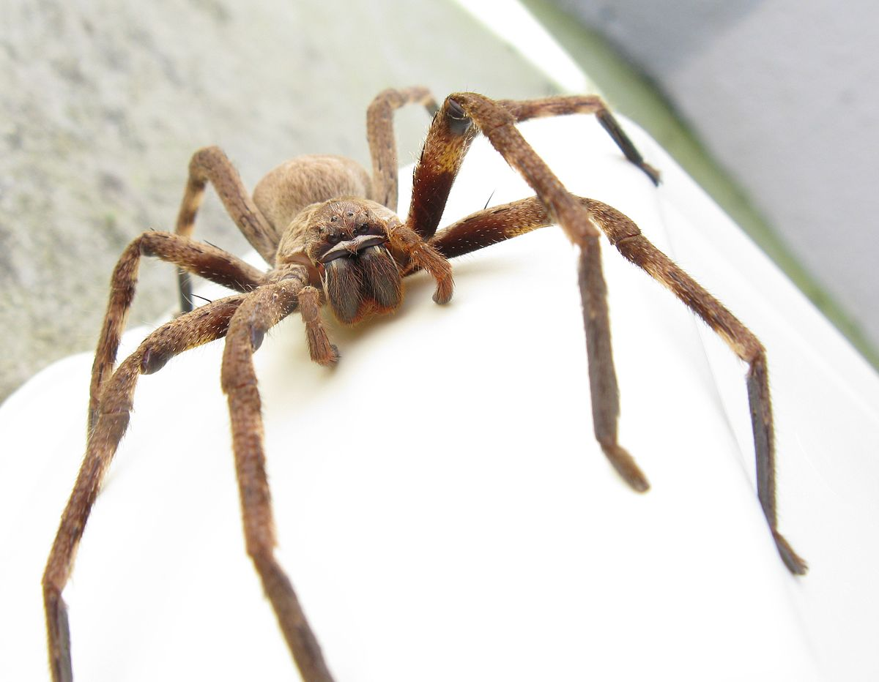


Slide 6
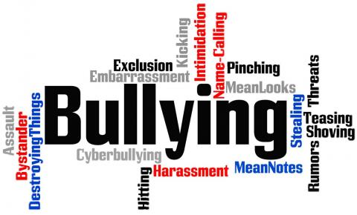
Defining Bullying
  a) Harmful or done with intent to harm
  Typically repeated or occur over time; and
  Characterised by an imbalance of power, such that the victim does not feel he or she can stop the interaction.

Slide 7
Typical Anti-Bullying Programs
  ~whole school approach
What bullying is … and how common it is
The different forms of bullying
The effects of bullying
That it can happen to anyone … by anyone …
What to do if someone picks on you
Bystander action (reducing social rewards for bullies)
Enhancing empathy and self-efficacy
Social/relational skills training
Strict limits on behaviour - with consequences
How the school will deal with bullying
Hot spot supervision

Slide 8
Meta-analysis: Gaffney, Ttofi, and Farrington (2019)
Looked at 65 anti-bullying programs, including Bully Proofing Your School, fairplayer.manual, KiVa, NoTrap!, OBPP, Second Step, Steps to Respect, and ViSC
The meta-analysis found that anti-bullying programs were collectively effective in reducing school-bullying perpetration by around 19–20% and school-bullying victimization by around 15–16%.

Slide 9
Most effective in reducing victimisation: NoTrap!
Peer-led online forums (in conjunction with peer-led offline anti-bullying activities)
Not as effective as some other programs in reducing perpetration. Argued that it needs to include ‘hot-spot supervision’.

Slide 10
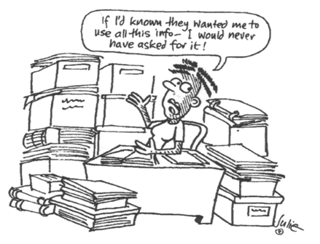
1. Effective data collection & use
A method is needed to regularly collect relevant data on bullying, which is then used to monitor and prioritise needs.

Slide 11
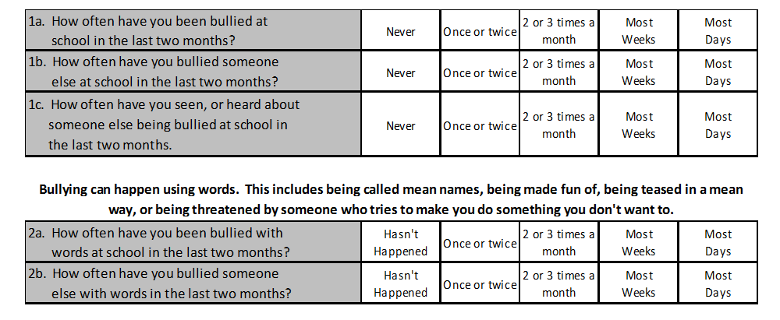
4-6 Low level
7-9 Moderate level
10+ Severe bullying

Slide 12

2. Hot-spot Supervision

Slide 13

3. Provide multiple ways for students to report bullying

Slide 14

4. Teachers as Modellers
There is evidence that peer perceived popularity is a direct reflection of teacher preference (Ladd et al., 1999) and that teachers, by the attitudes they portray towards different students, play a significant role in determining the students who are deemed popular in the eyes of their peers.
Deference shown to students who exhibit aggressive behaviour may increase their social standing and increase their ability to influence peer group norms.

Slide 15

5. Recognition of Prosocial Behaviour
Early recognition & development of prosocial leaders
Developing a school climate where students believe there is more to be gained by prosocial rather than aggressive behaviour.

Slide 16
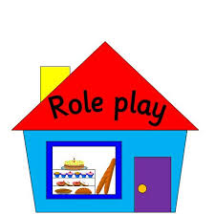
6. Teach Particular Strategies for dealing with bullies
Discuss & role-play strategies.
a) Cry, sulk, ‘spin out’.
b) Get back at the bully (aggression)
c) Ignore the bully. “Walk”
d) Deflection
e) Assertive language.
[Adult state, Command, Refuse to Divert, Give Choice]

Slide 17
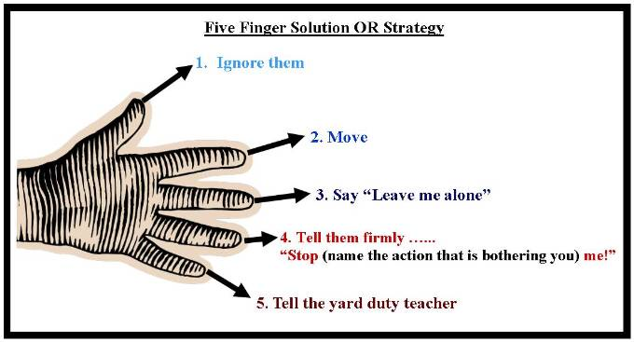
Example of a strategy for young children

Slide 18

7. Student Led
[Particularly at secondary level]

Slide 19
8. Understanding Participant Roles
Bully
Bully
Supporter
Reinforcer
Active
Bystander
Victim
Passive Bystander

Slide 20
9. Monitoring School Climate
Teacher-student Relationships
Student-student relationships
Belonging/connectedness
Authority structure / classroom management
Academic support
Attitudes towards aggression
Perception of buildings/classroom/facilities (neatness etc.)
Perceived exclusion/privilege
Feeling safe
There is a significant relationship between positive school climate and less aggressive behaviour.

Slide 21
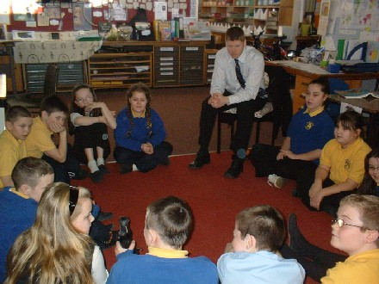
10. Circle Time
This can include;
Working with individual victims & perpetrators
Social skills development
“Accountability”
Support groups
‘Circle time’

Slide 22

11. Understanding Peer Ecologies
Sociometric Vs Perceived Popularity
Measuring & monitoring social status
Teacher identification of popularity

Slide 23
Popular Students…
Kind
(prosocial)
Unkind
(aggressive)
Bullies…
Unpopular
Very Popular

Slide 24
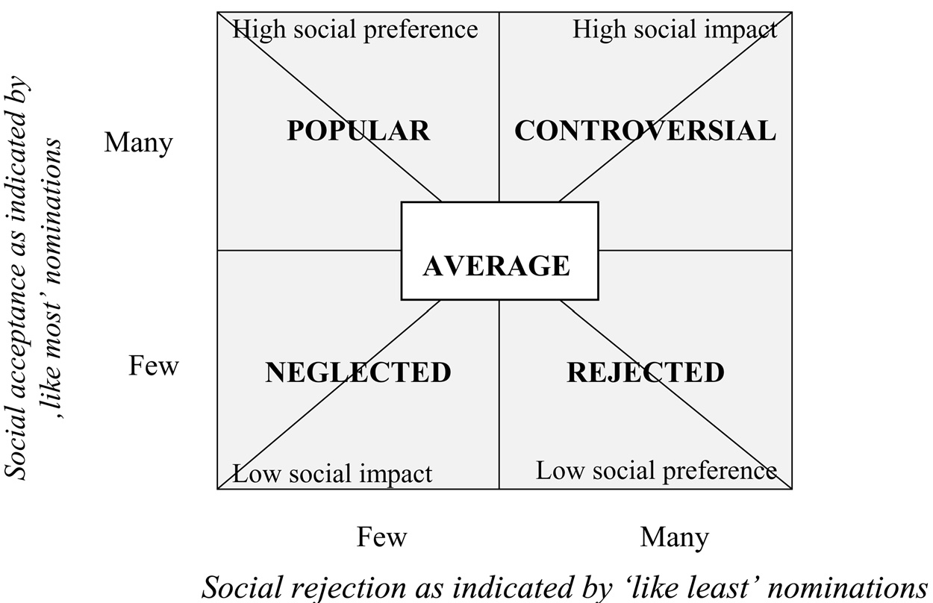

Slide 25
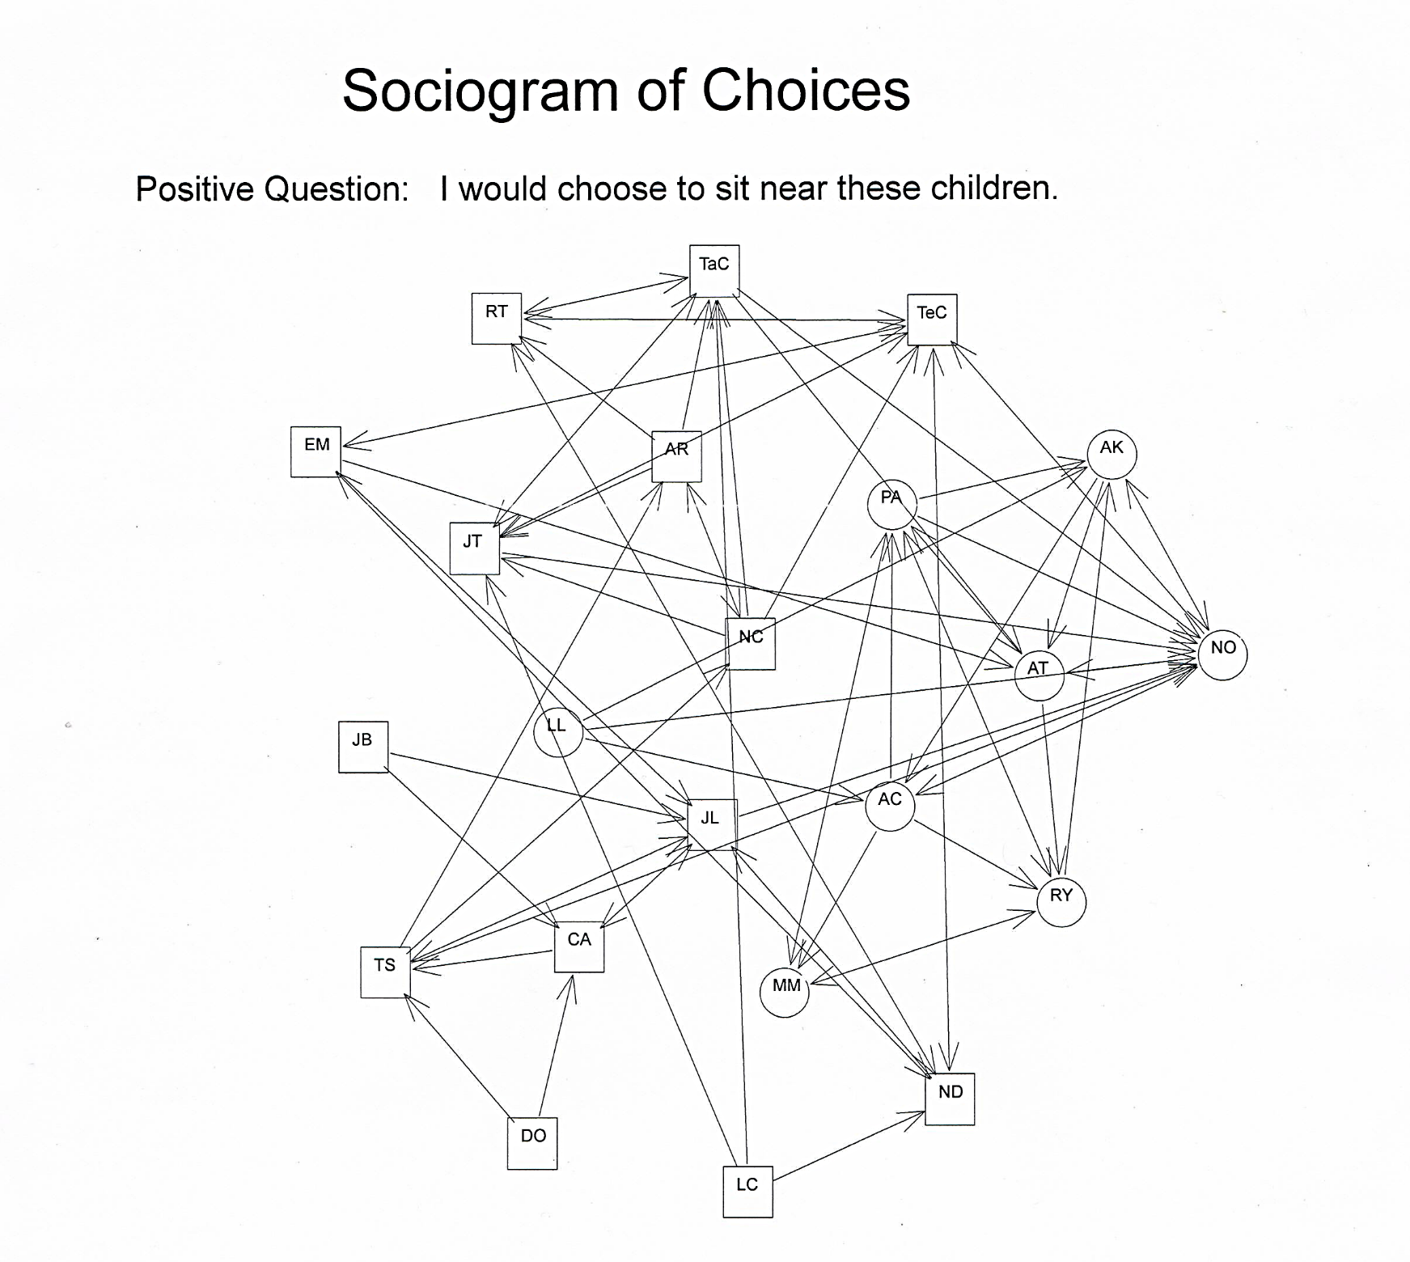
http://www.classroomsociometrics.com/

Slide 26
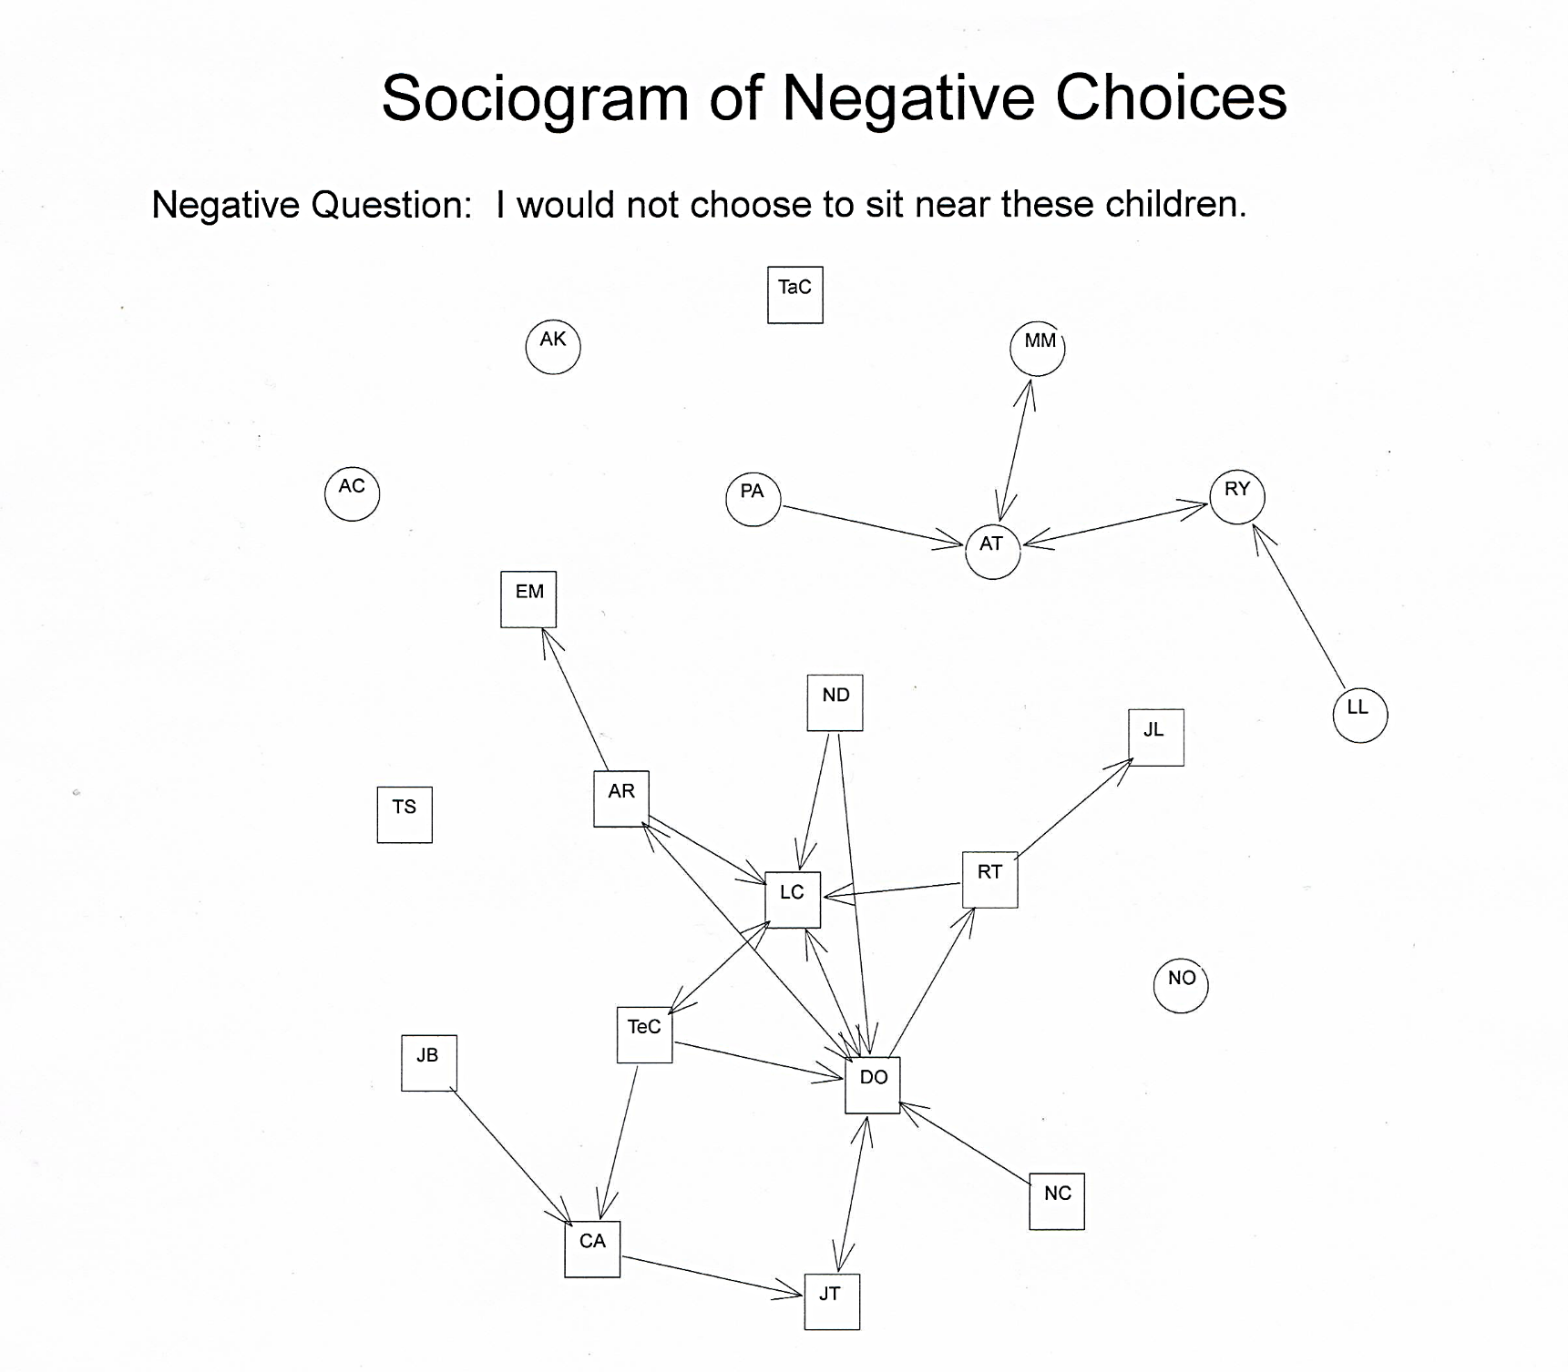

Slide 27

The ‘Gravity’ of Classroom Norms
What is ‘rewarded’?
The 80/20 principle
Classroom Norm:
Aggressive Behaviour
Perceived popular students
Sociometric popular students
Classroom Norm:
Pro-Social Behaviour

Slide 28
Development
of
Bullying
Neglected
Rejected
Bullied

Slide 29
12. Building Resiliency
1. Friends (including quality, number of, & social standing ).
2. A child’s attributions of the reasons for their peer difficulties.
3. Coping strategies (for example; deflection & assertiveness training)
4. Significant adults

Slide 30
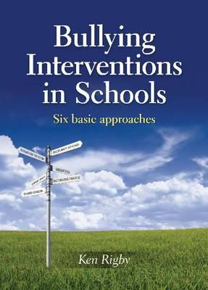
13. Explore a variety of ways to
respond to reported bullying incidents.
the traditional disciplinary approach
strengthening the victim
mediation
restorative justice
the support group method
the method of shared concern

Slide 31
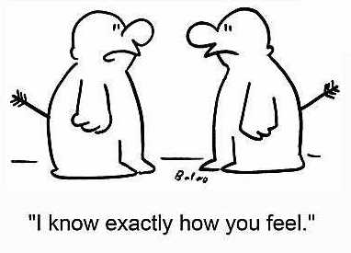
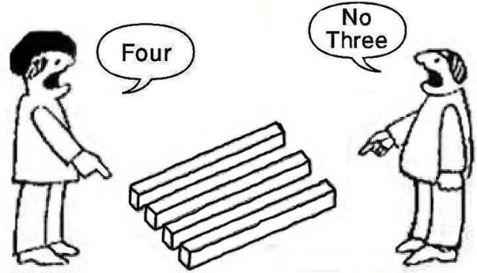
14. Developing Empathy & Perspective Taking

Slide 32
15. Student buy-in – to 7 key ideas
Speak up
Kind contact
Bystander power
Be a circuit breaker
Think first
Ownership & control
Forgiveness

Slide 33
Students
Parents
Whole School (Admin)
Classroom Teachers

Slide 34
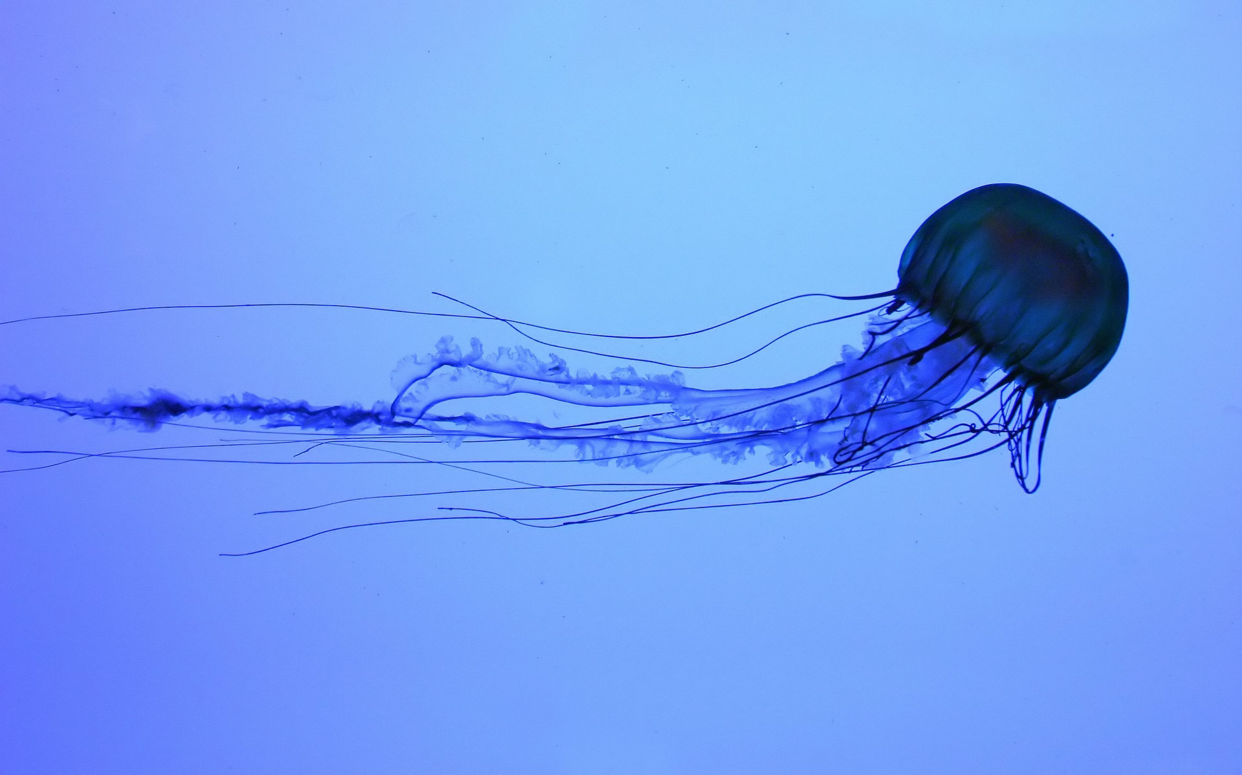

Slide 35
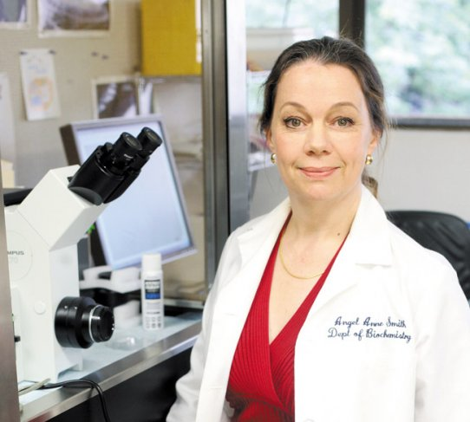
Professor Angel Yanagihara
“Venom Blockers”

Slide 36

Seven Key Ideas we need students to buy into

Slide 37

Speak Up

Slide 38
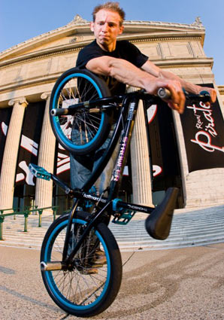
Matt Wilhelm
Three X Games medals
Two national championships (USA)
Silver medal from the World Championships
https://www.youtube.com/watch?v=KDteUF4GEe0

Slide 39
Young children will need training in aspects such as tattling vs telling.
Have a program that also emphasizes speaking up about the positive.
Use plenty of narratives about people who have spoken up in various areas of life. “Normalise it.”

Slide 40
While young students are often quick to speak up …Adolescents would speak up more if:
There were multiple ways of being able to speak up (including anonymous)
They were confident in the school’s method of dealing with what they had to say
The social cost vs social benefit ratio was acceptable

Slide 41

Make Kind Contact

Slide 42

Use Bystander Power

Slide 43
The Bystander Effect
https://www.youtube.com/watch?v=OSsPfbup0ac

Slide 44
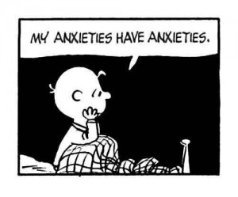
Four considerations….
Teach multiple ways of responding
Address pluristic ignorance [misconceptions]
Turn rumination into co-rumination
Utilise the power of narrative

Slide 45

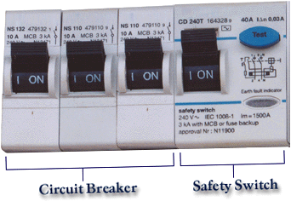
Be a circuit breaker

Slide 46
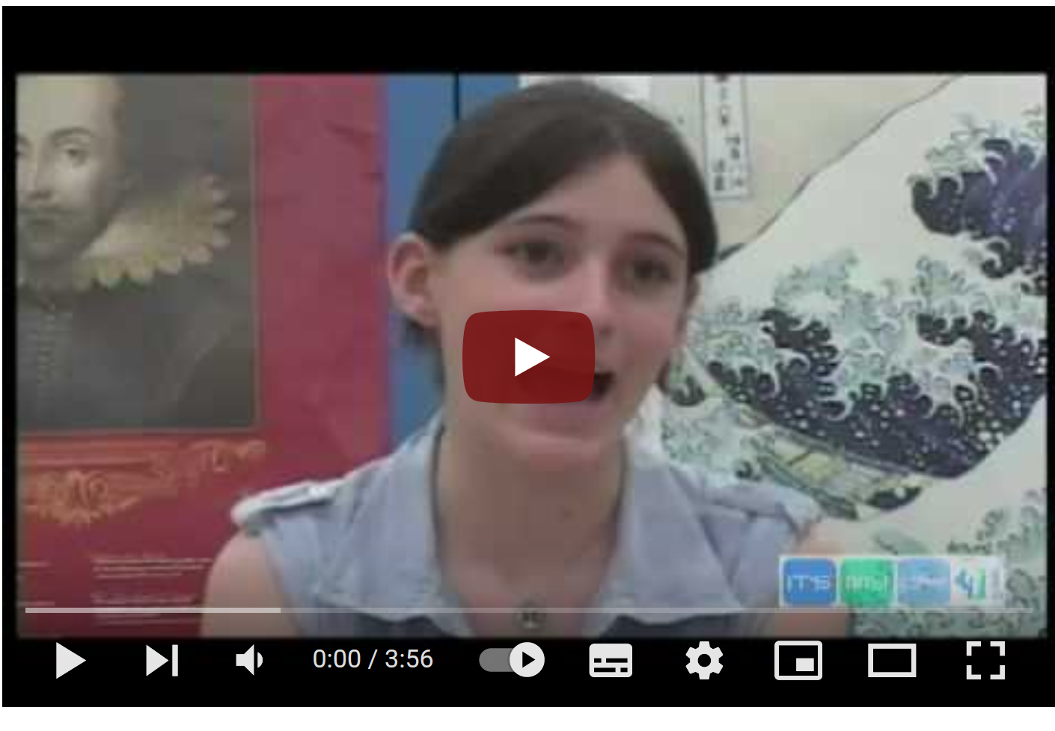
Why students gossip
https://www.youtube.com/watch?v=98SChJzflD4

Slide 47
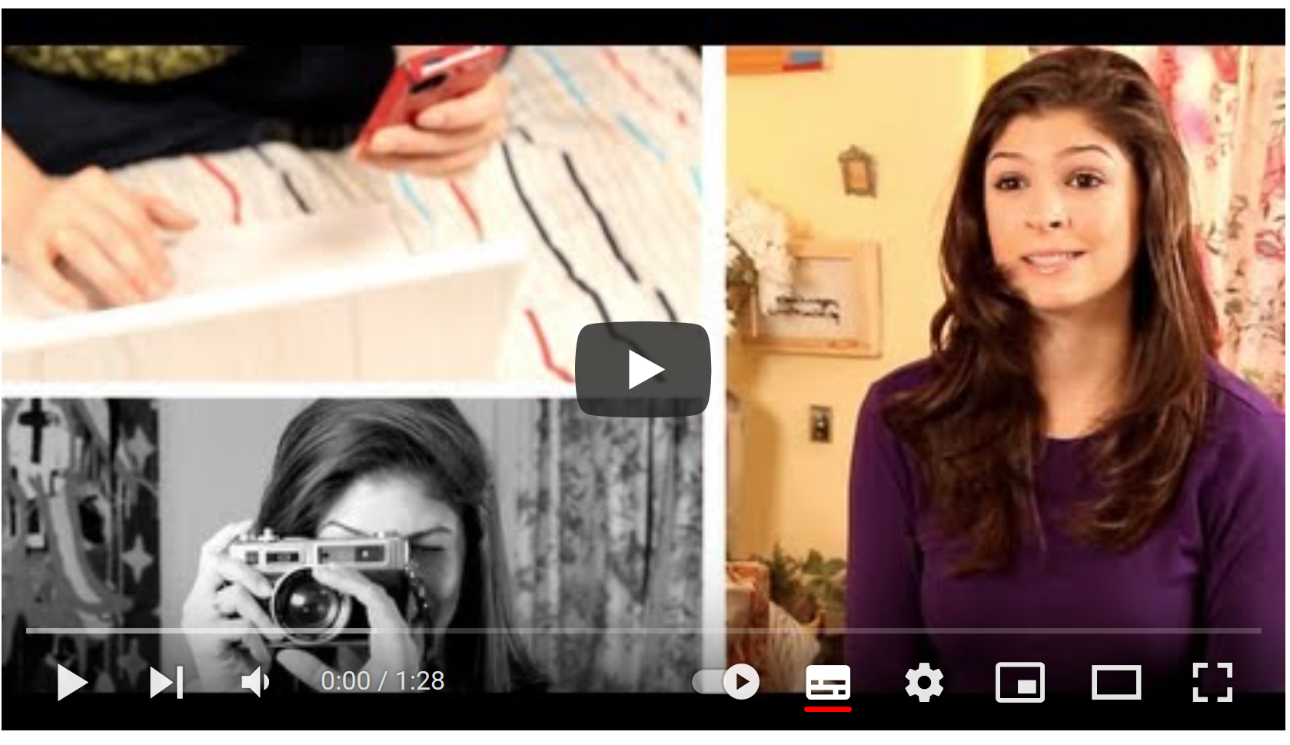
Dealing with gossip and rumour in upper primary and/or middle school.
https://www.youtube.com/watch?v=PL4b7SK0ZLU

Slide 48
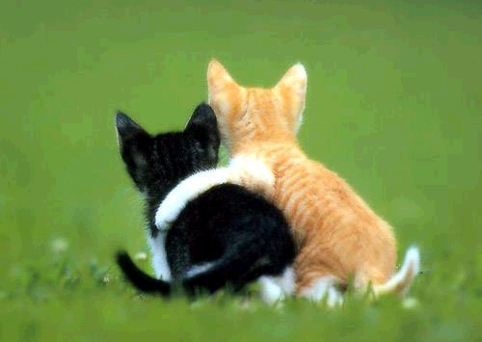
“He who covers over an offense promotes love, but whoever repeats the matter separates close friends.” Proverbs 17:9

Slide 49


Would I be comfortable to say this in front of the whole school?

Slide 50
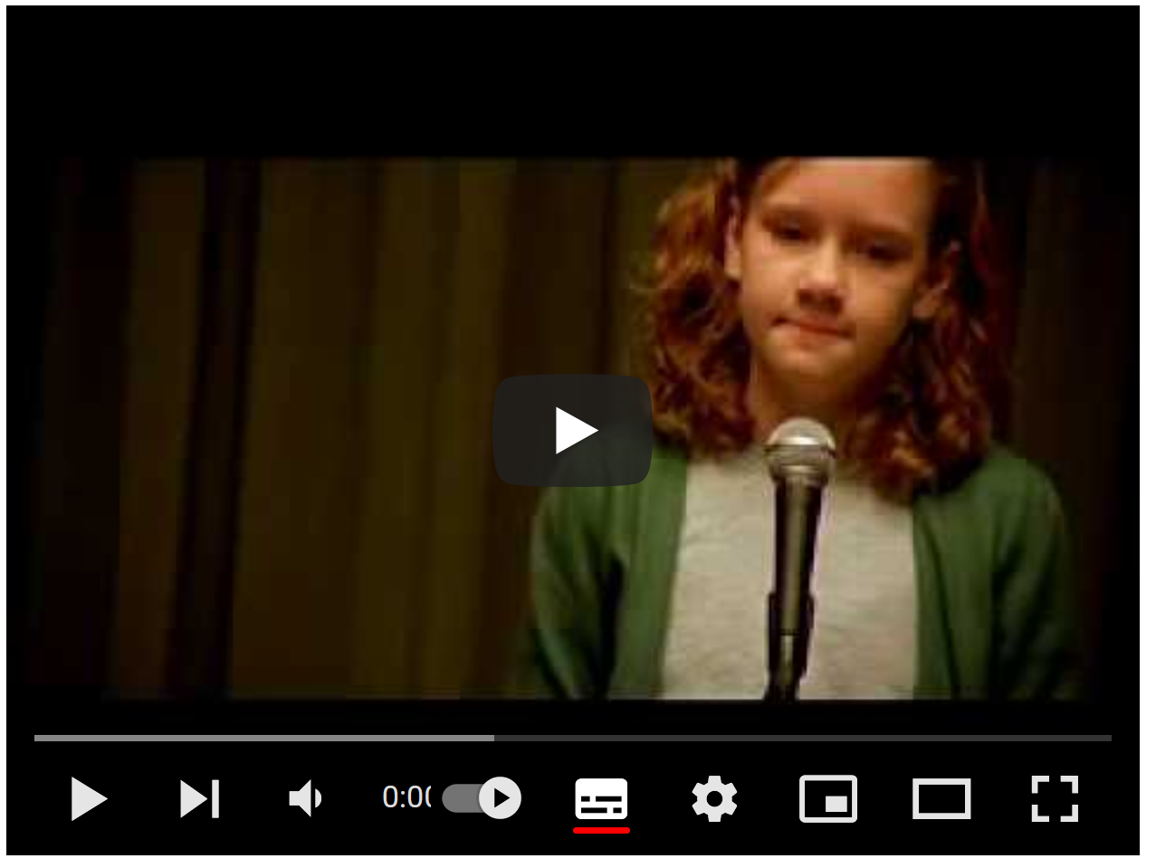
The Talent Show
https://www.youtube.com/watch?v=dYDRoJJMGJo

Slide 51

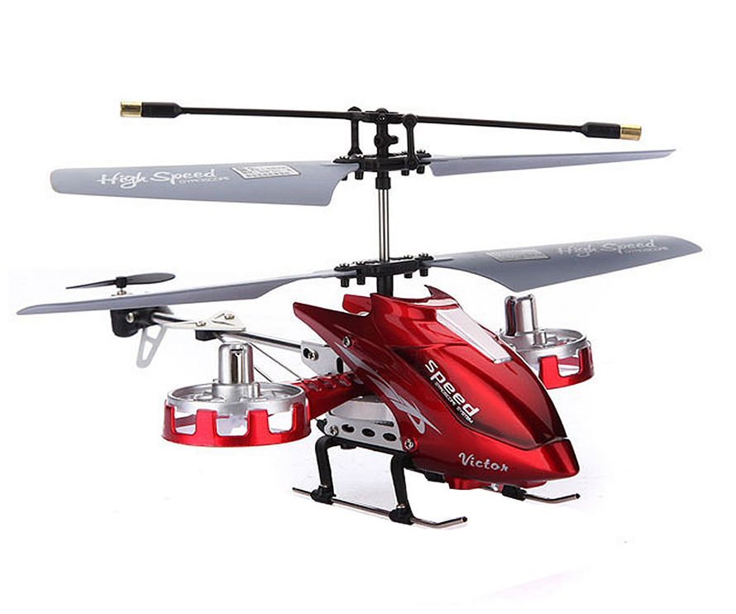
Ownership and Control

Slide 52
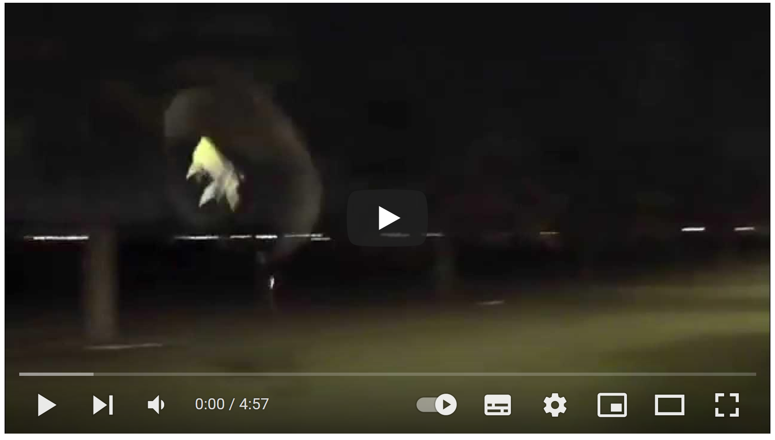
Radio control helicopter
https://www.youtube.com/watch?v=W170zszmkWk

Slide 53


Don’t try and own people or control your friends.
Don’t let other people own or control you.

Slide 54



