Slide 1
Growing Amidst the Challenges
Trans-European Division
Quinquennial Education Convention
Hotel Izvor
Serbia
July 26-30, 2023

Slide 2
The Measure of Success
What will judge us as having achieved our goals?

Slide 3
"In effect we are forced to turn our eyes from the contemplation of where we would like to see God revealed, and to turn them instead upon a place which is not of our own choosing, but which is given to us.”

Slide 4
“As the history of human thought demonstrates, we like to find God in the beauty of nature, in the brilliance of an inspired human work of art or in the depths of our being - and instead, we must recognize that the sole authorised symbol of the Christian faith is a scene of dereliction and carnage.”
Alister McGrath

Slide 5
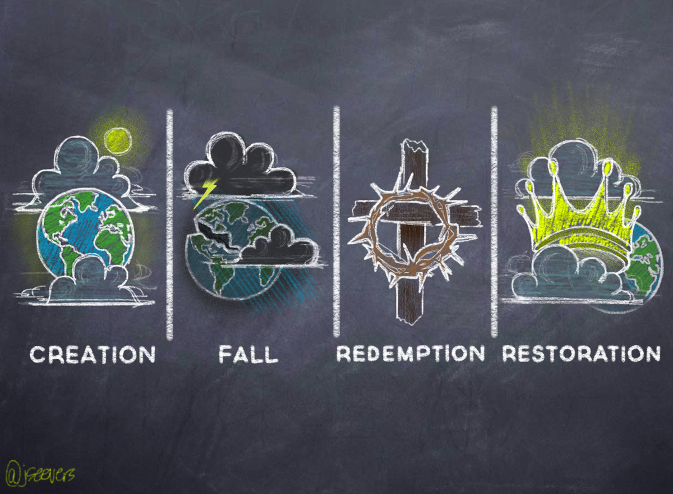
We came into existence by the act of loving God, whom we were created to be in relationship with. God continues to sustain all creation. | Satan aims to discredit God and to destroy His image in creation. The entrance of sin has changed our nature, ideals & values. | God takes the initiative to reveal himself, offering mercy & grace. Divine power is given to restore the imagine of God in the soul. | Christ will return to make all things new. Sin will never again be present in the universe.

Slide 6
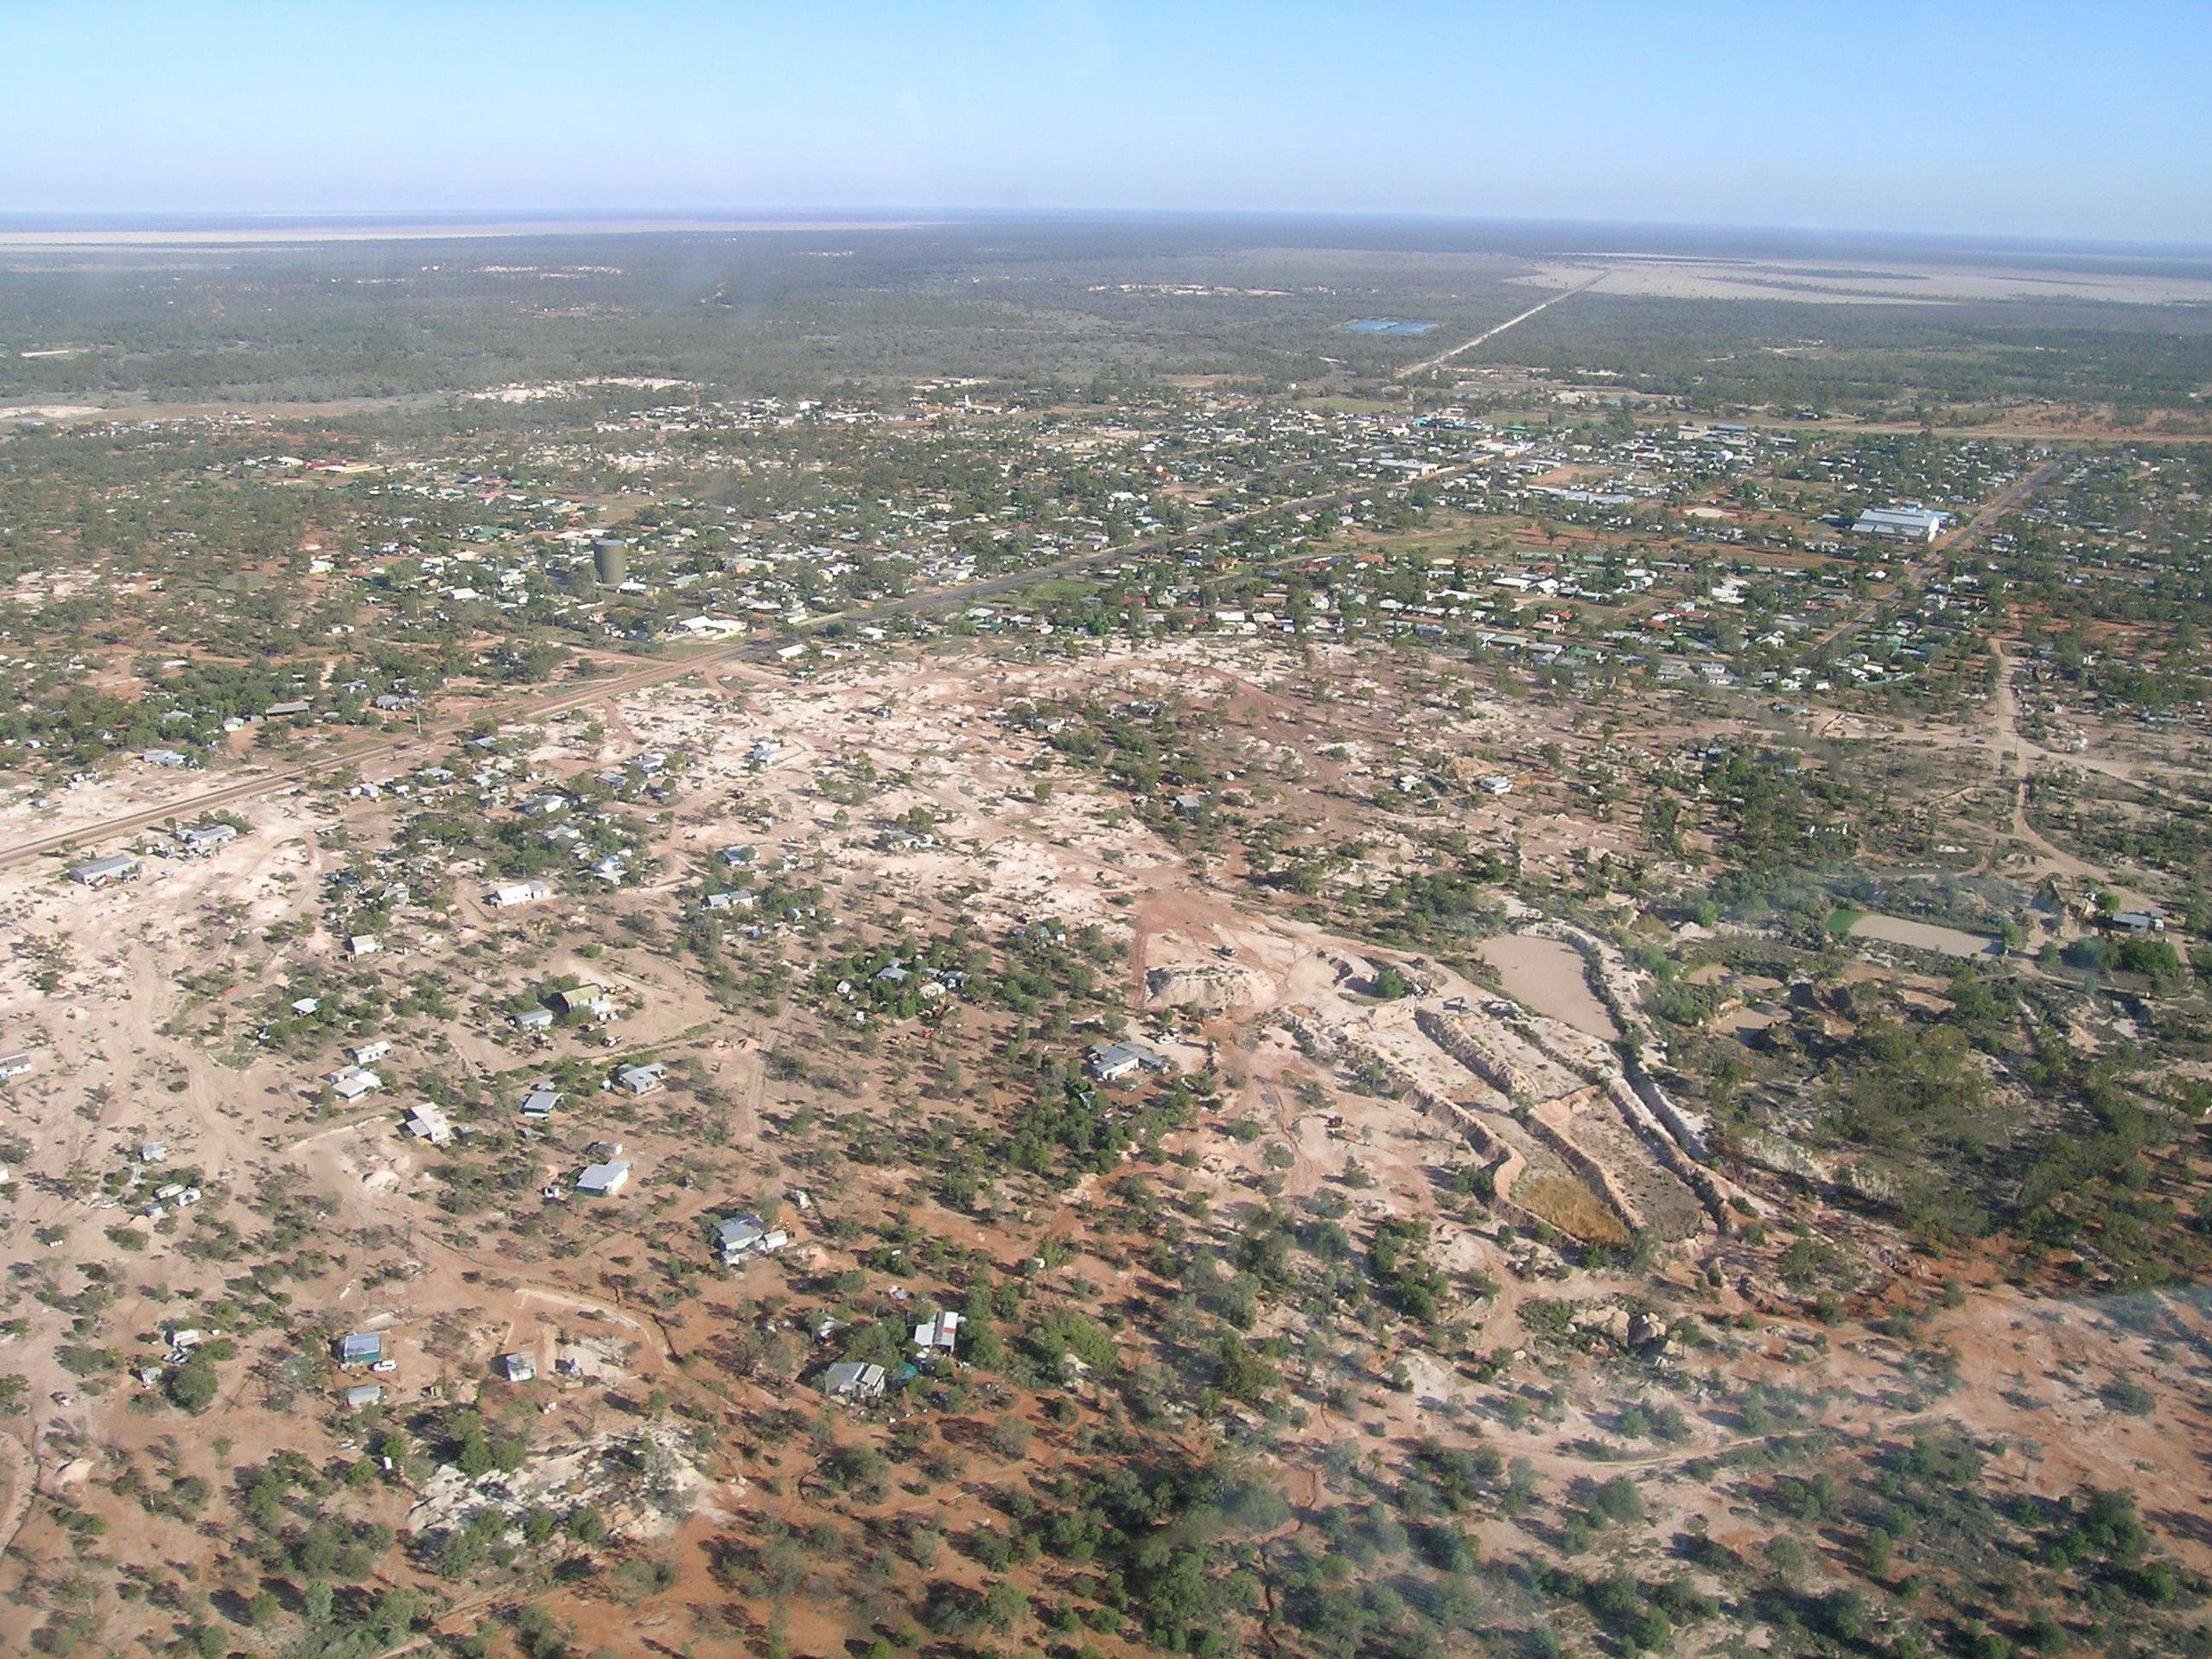

Slide 7
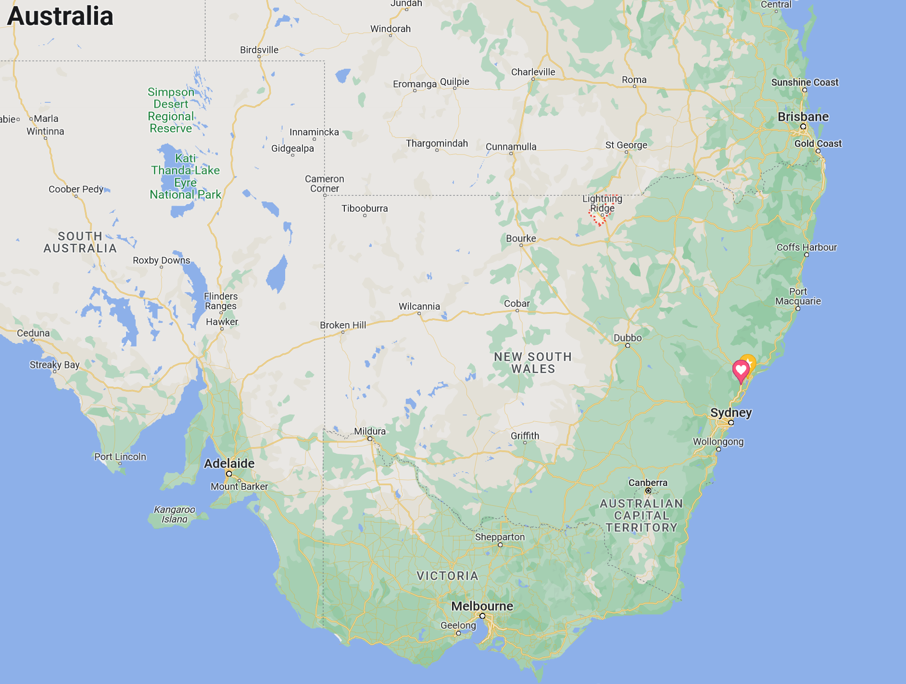

Slide 8
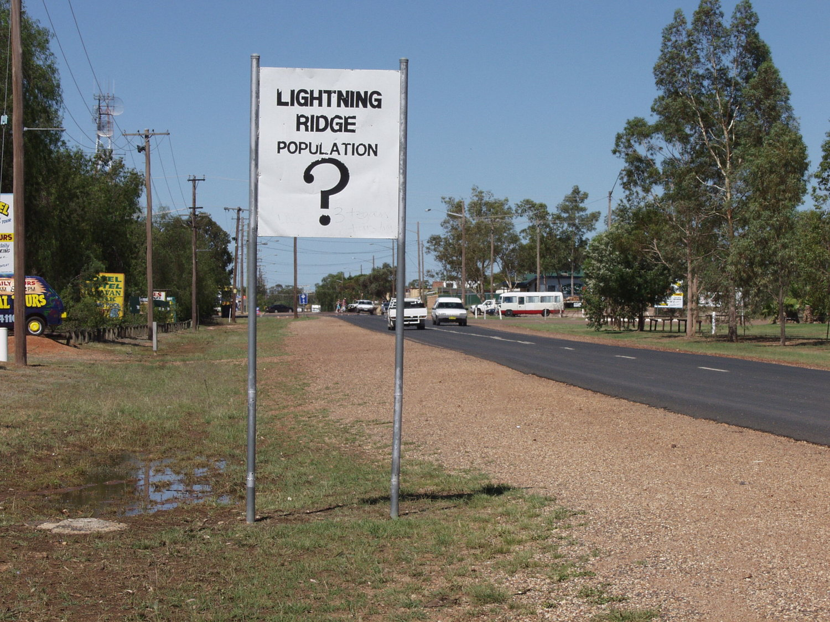

Slide 9
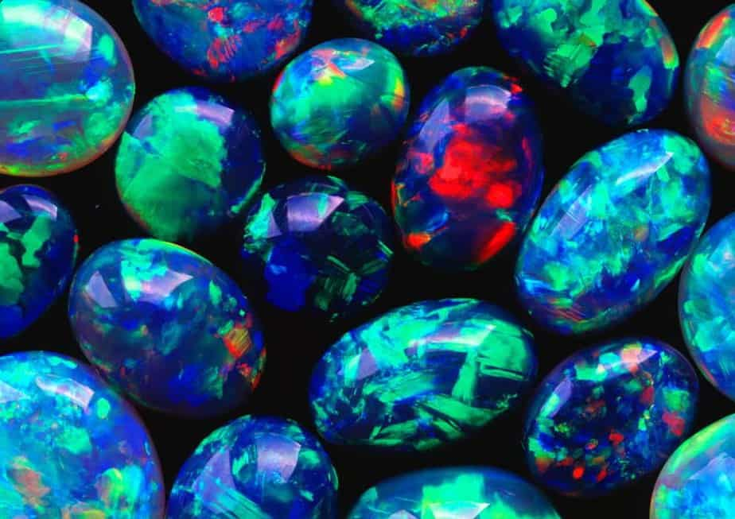

Slide 10
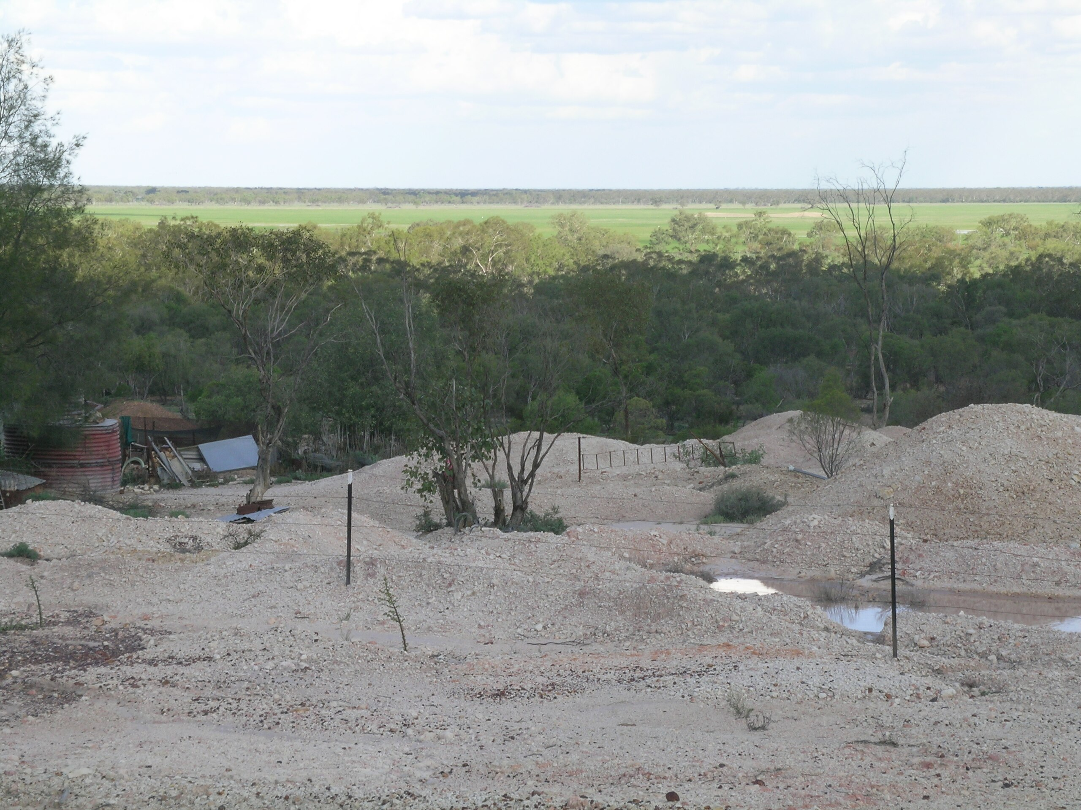

Slide 11
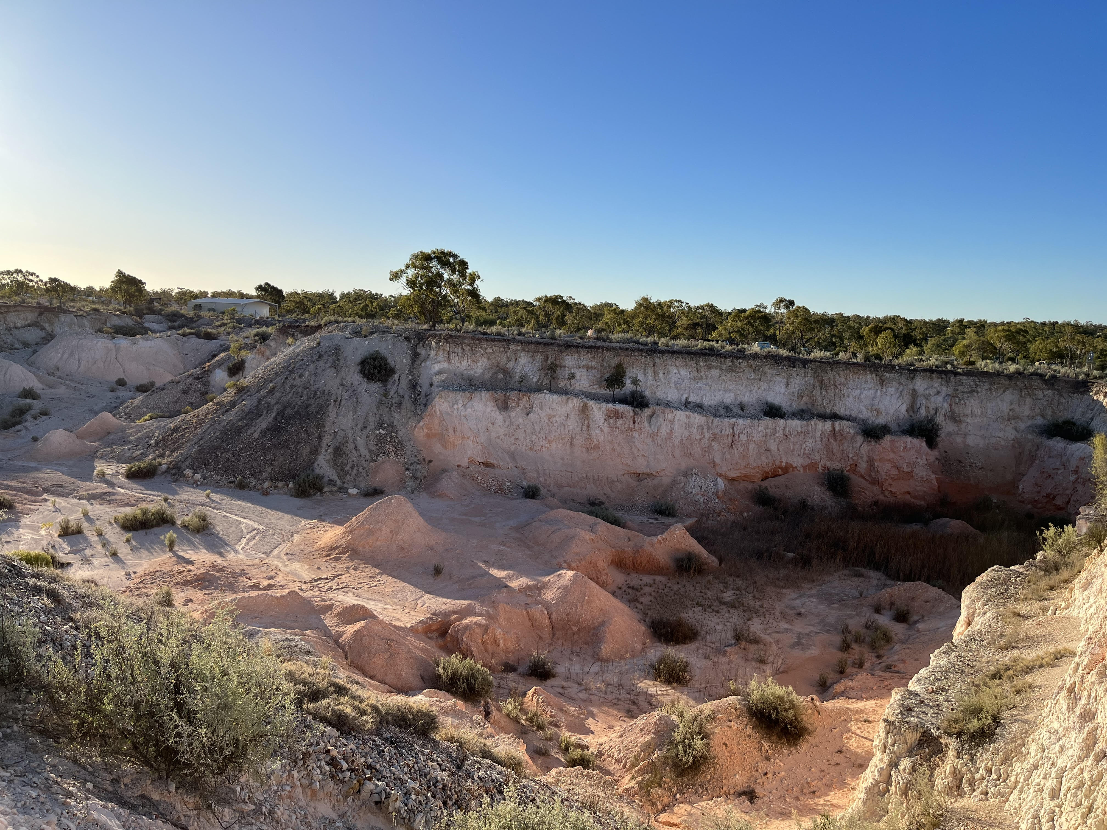
Lunatic Hill, Lightening Ridge

Slide 12
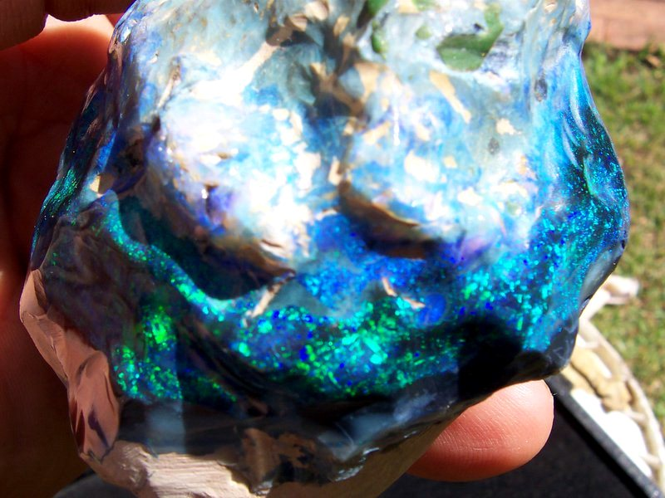

Slide 13
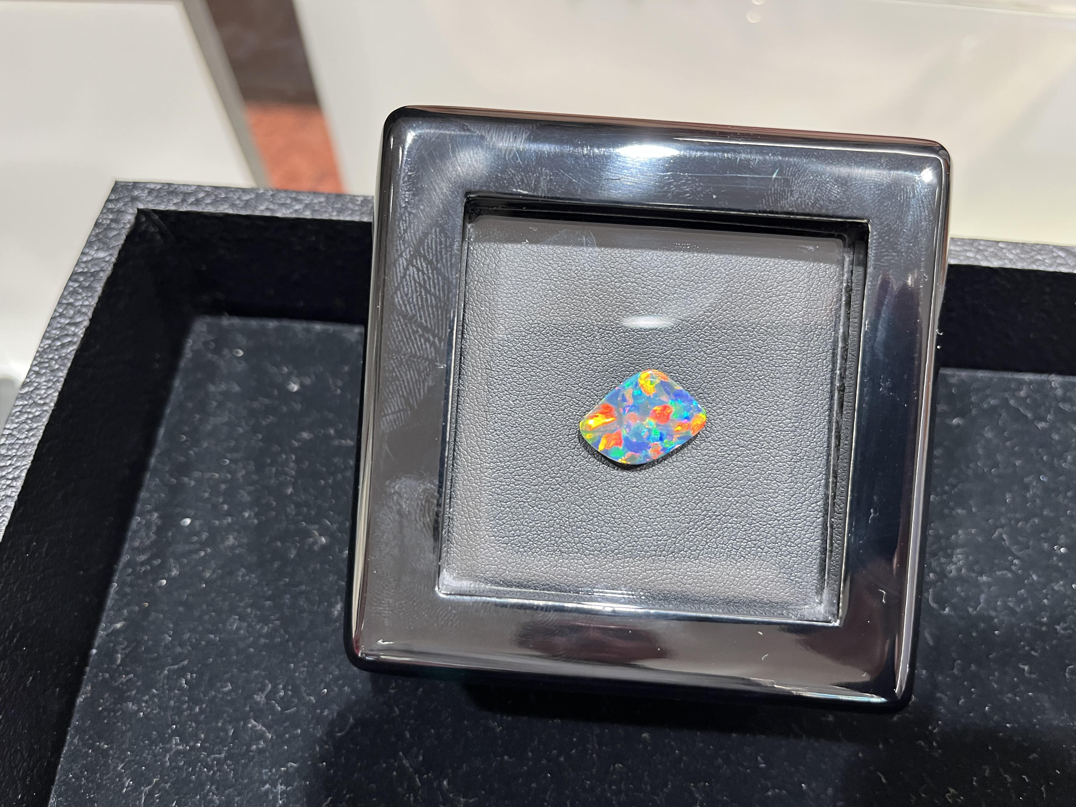

Slide 14
“In every human being he discerned infinite possibilities. He saw men as they might be, transfigured by His grace—in “the beauty of the Lord our God.” Looking upon them with hope, He inspired hope. Meeting them with confidence, he inspired trust. Revealing in Himself man's true ideal, He awakened, for its attainment, both desire and faith. In His presence souls despised and fallen realized that they still were men, and they longed to prove themselves worthy of His regard. In many a heart that seemed dead to all things holy, were awakened new impulses. To many a despairing one there opened the possibility of a new life.”
Education, p. 80 [Chapter 8 – The Teacher Sent From God]

Slide 17
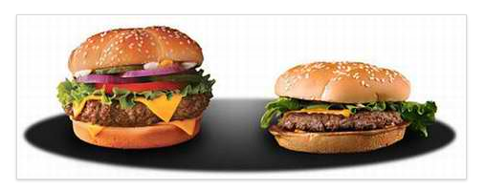
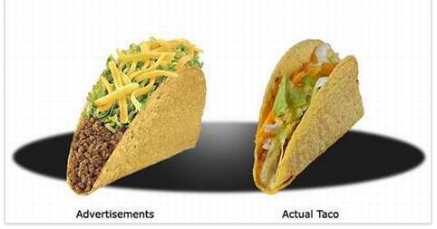

Slide 18
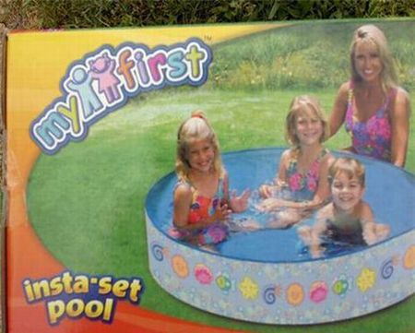
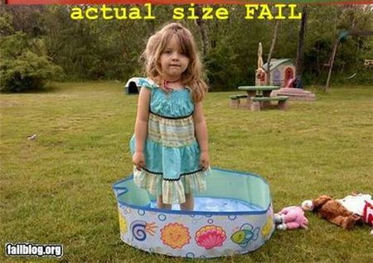

Slide 19
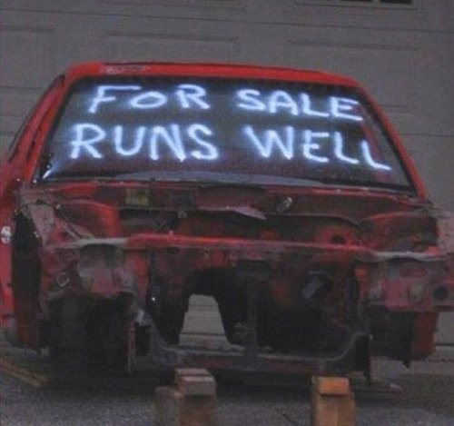

Slide 21
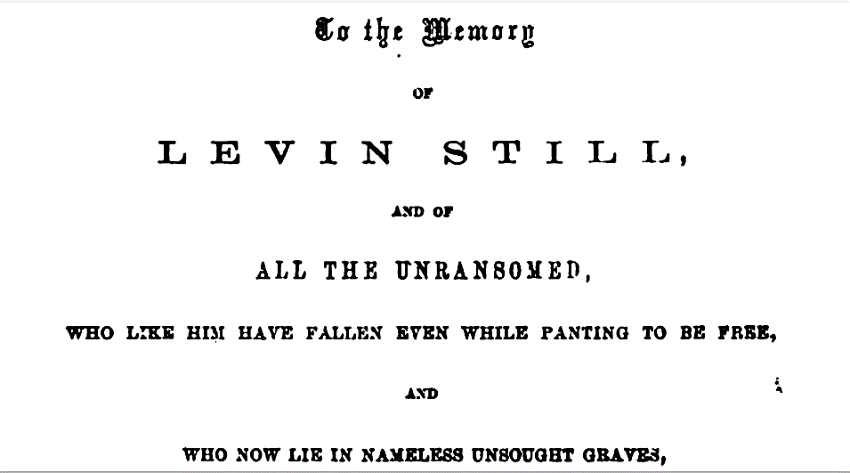

Slide 22
We came into existence by the act of loving God, whom we were created to be in relationship with. God continues to sustain all creation. | Satan aims to discredit God and to destroy His image in creation. The entrance of sin has changed our nature, ideals & values. | God takes the initiative to reveal himself, offering mercy & grace. Divine power is given to restore the imagine of God in the soul. | Christ will return to make all things new. Sin will never again be present in the universe.

Slide 23
Prof Perry Glanzer, Baylor University
Children/youth see the ways in which significant adults in their lives are responding to God’s story
Children/youth understanding how they fit into God’s story

Slide 24
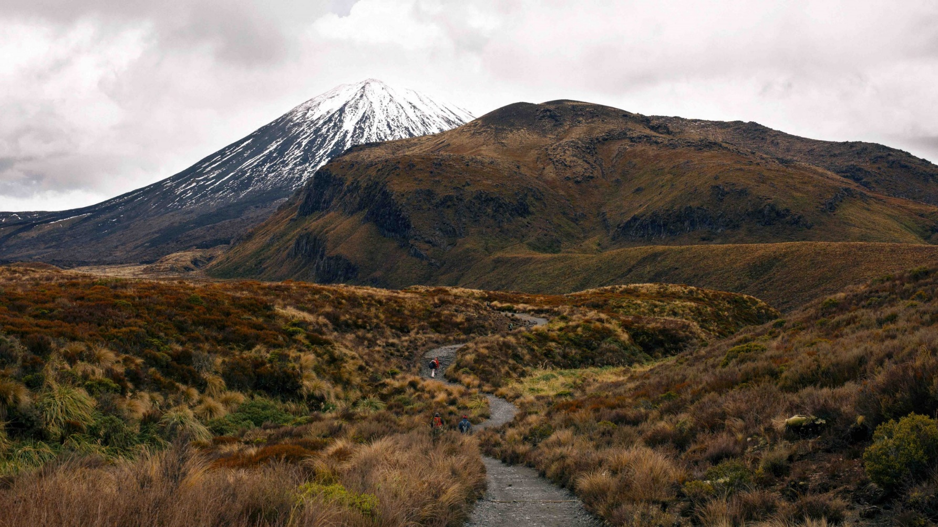

Slide 25
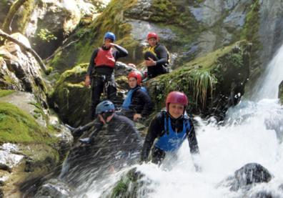
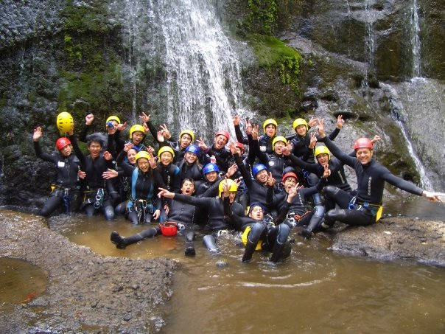

Slide 26
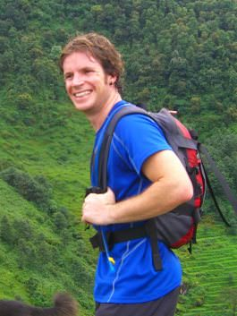

Slide 27
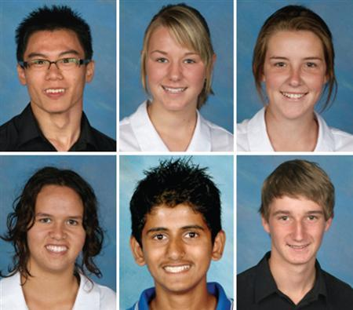
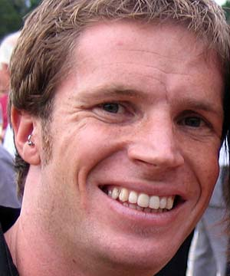

Slide 28
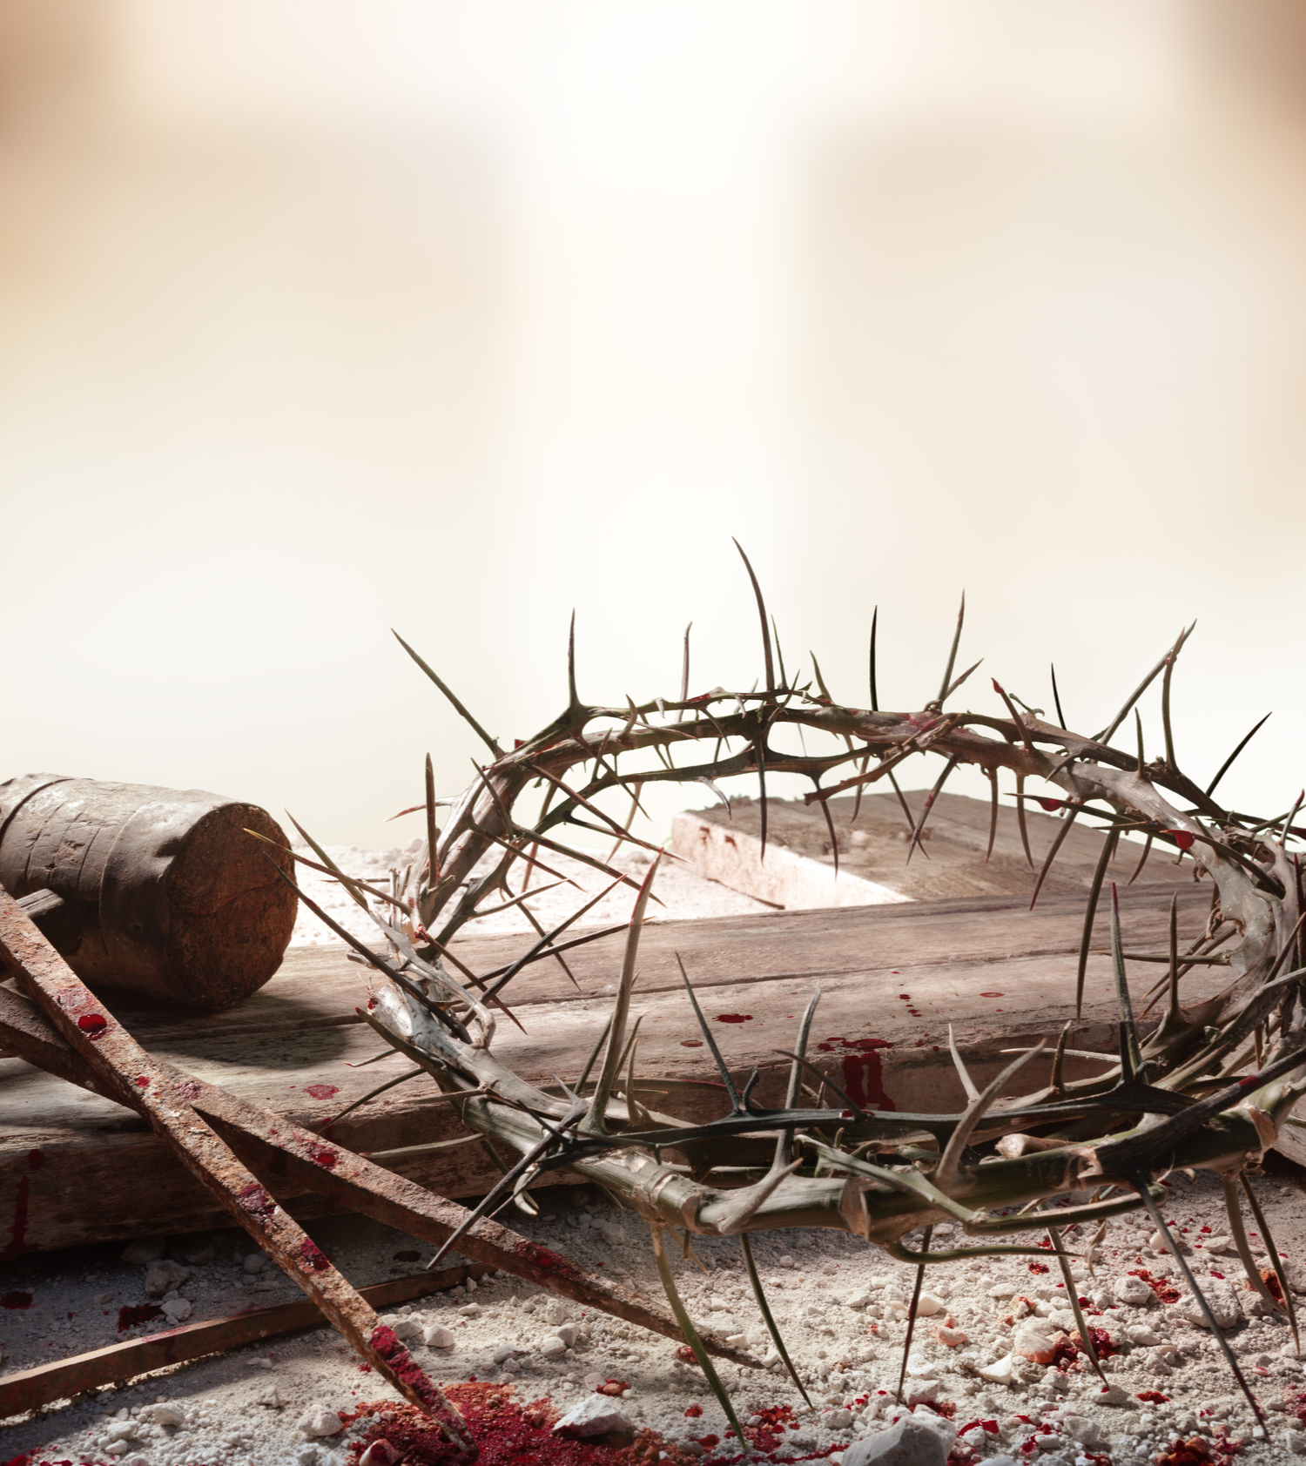
This is love: not that we loved God, but that he loved us and sent his Son as an atoning sacrifice for our sins.
1 John 4:10

Slide 29
Now to Him who is able to do immeasurably more than all we ask or imagine, according to His power that is at work within us. Ephesians 3:20

