Slide 1
Growing Amidst the Challenges
Trans-European Division
Quinquennial Education Convention
Hotel Izvor
Serbia
July 26-30, 2023

Slide 2
The Source of our Strength

Slide 3
Restore human beings into the image of God as revealed by the life of Jesus Christ.
Foster a balanced development of the whole person—spiritual, physical, intellectual, and social-emotional—a process that spans this world and the next.
Work together with home and church and in cooperation with divine agencies - to prepare learners to be good citizens in this world and in the next.

Slide 4
The fear of the LORD is the beginning of wisdom, and knowledge of the Holy One is understanding. Proverbs 9:10
True education does not ignore the value of scientific knowledge or literary acquirements; but above information it values power; above power, goodness; above intellectual acquirements, character. The world does not so much need men of great intellect as of noble character. It needs men in whom ability is controlled by steadfast principle.
EGW, Education, Chap 25

Slide 6
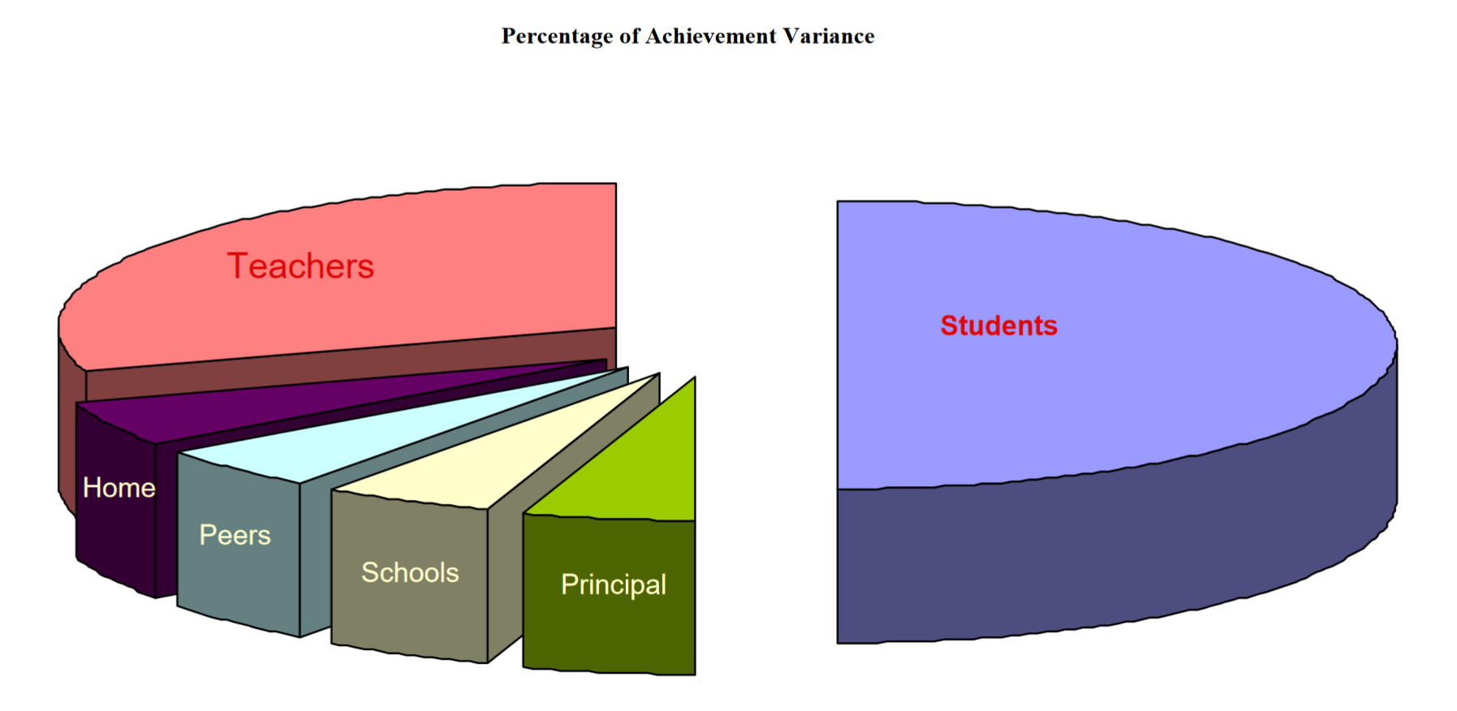
Hattie, J. (2003). Teachers make a difference: What is the research evidence? Paper presented at the Building Teacher Quality: What does the research tell us. Paper presented at the ACER Research Conference, Melbourne, Australia. Retrieved from http://research.acer.edu.au/research_conference_2003/4/

Slide 7
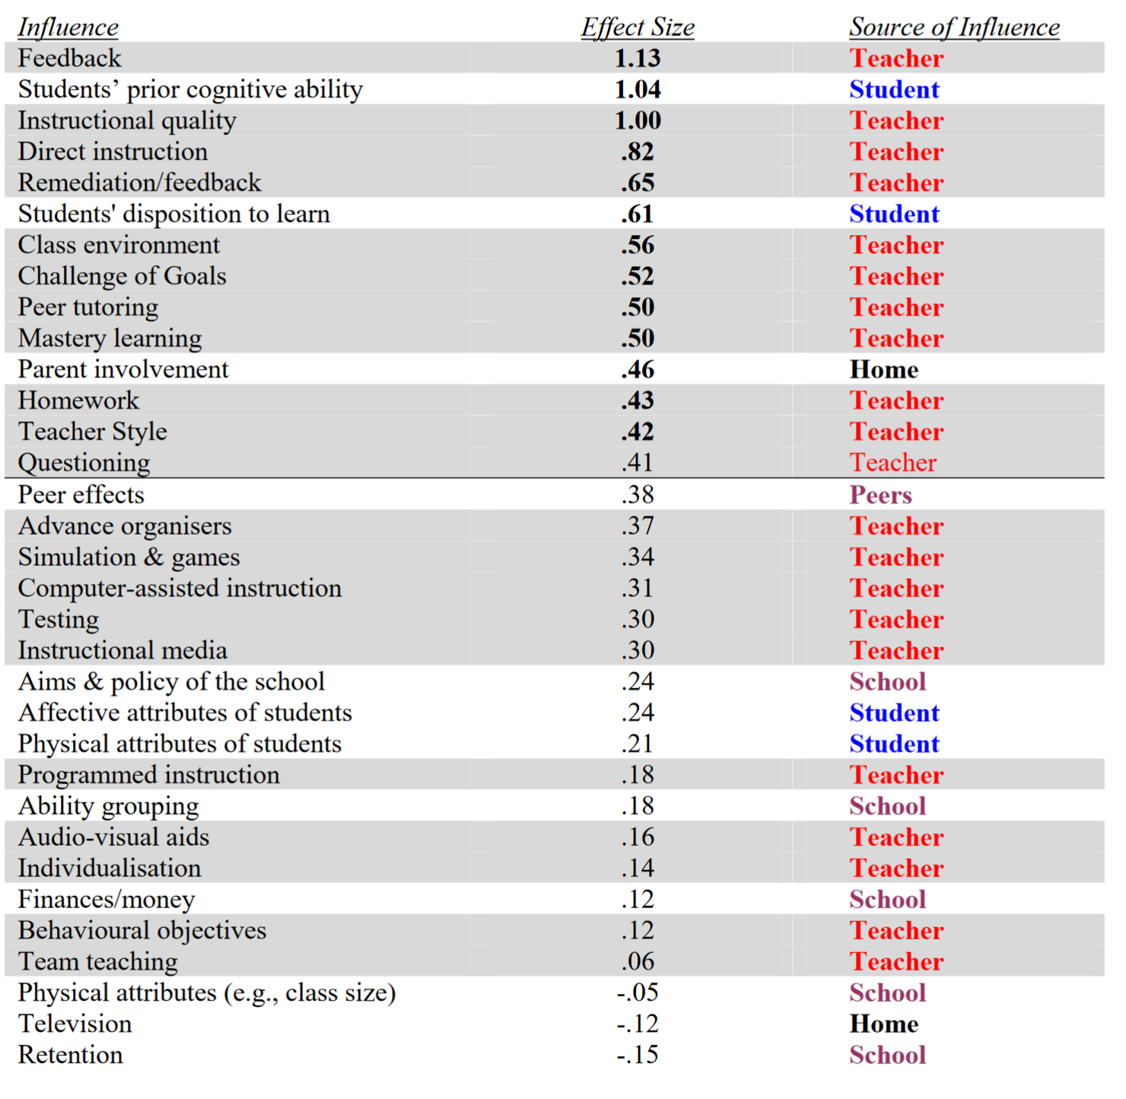

Slide 8
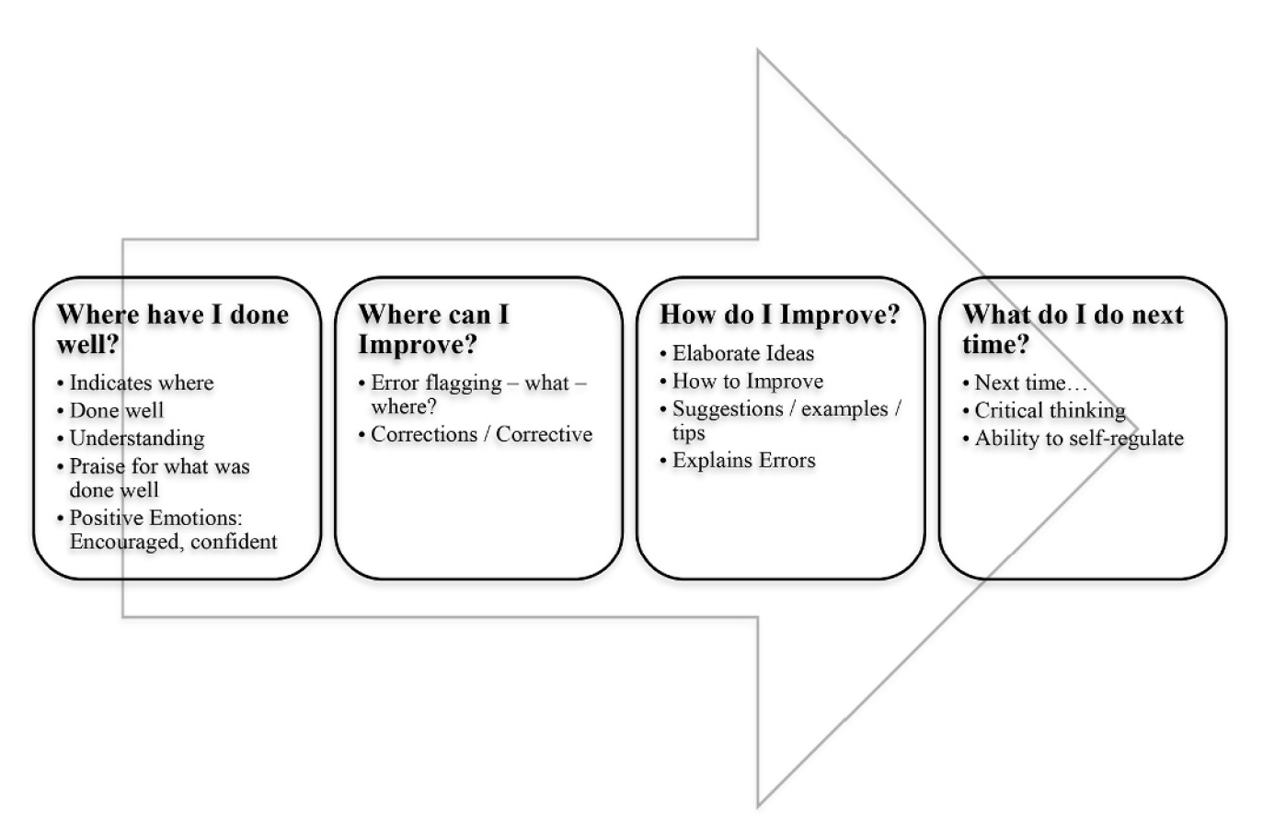
Mandouit, L., & Hattie, J. (2023). Revisiting “The Power of Feedback” from the perspective of the learner. Learning and instruction, 84, 101718. doi:10.1016/j.learninstruc.2022.101718

Slide 9
In thinking about how your school positively impacts the development of children/youth, what is one initiative your school has tried that has made a difference?
What initiative/s would your school like to try (or is planning to try)?
What comments or questions do you have about anything we have discussed so far this weekend?

Slide 10
1. Student-level factors
2. Home/Family level factors
3. School/Society level factors
4. Classroom-level factors
5. Teacher-level factors
6. Curriculum-level factors

Slide 11
1. Student-level Factors

Slide 12
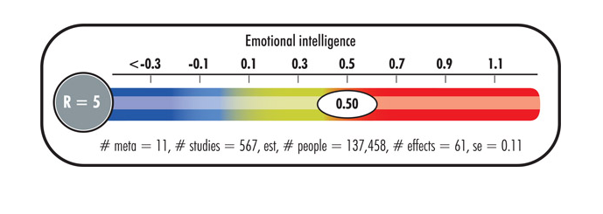
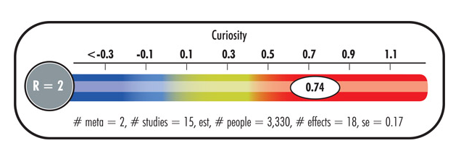

Slide 13
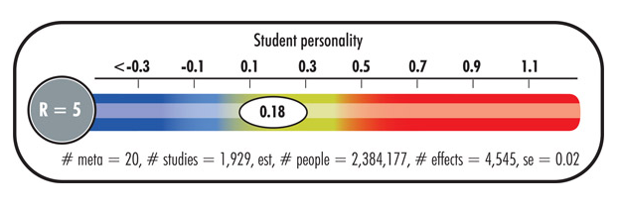

Slide 14
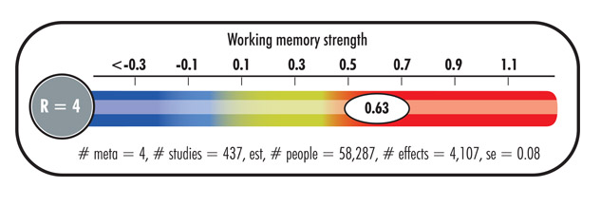

Slide 15
2. The Home & Family

Slide 17
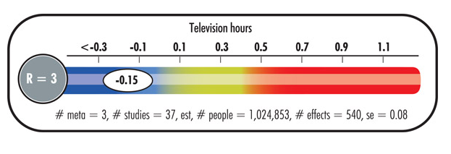

Slide 18
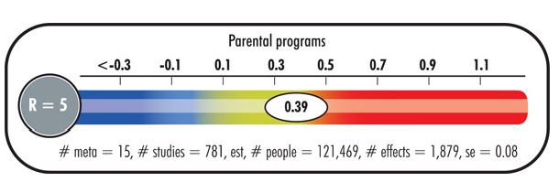
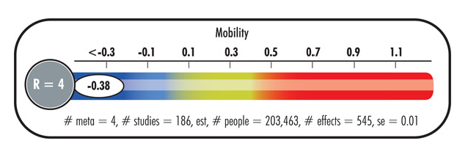

Slide 19
3. The School & Society

Slide 21
Positive Student-Teacher Relationships
School Connectedness
Order, Discipline & Safety
Opportunities for Student Engagement
School Physical Environment
Academic Support
Parental Involvement
Perceived Exclusion/Privilege
School Social Environment
Academic Satisfaction

Slide 22
academic achievement
learning motivation
school attendance
involvement
self-esteem
depressive symptoms
school delinquency
general health outcomes
alcohol abuse
risk taking behaviour
classroom behaviour
resilience
bullying perpetration
interest in developing a faith
teacher retention rates
Notes:
Melbourne project. Difference in two Lalor Schools.

Slide 23
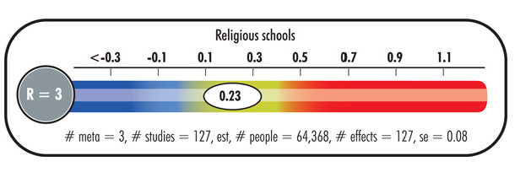

Slide 24
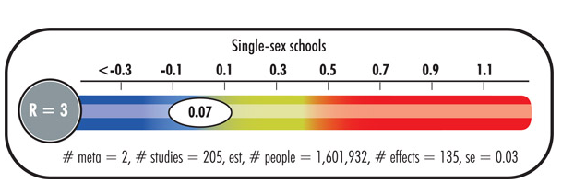
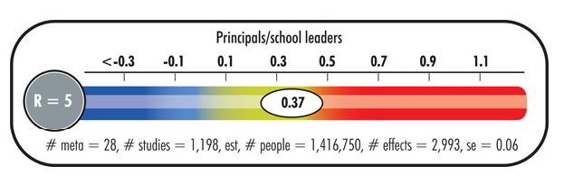

Slide 25
4. The Classroom

Slide 27
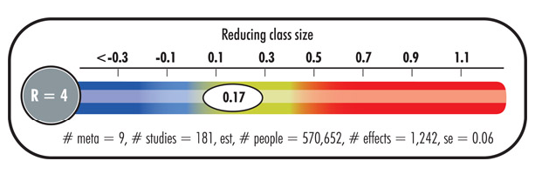

Slide 28
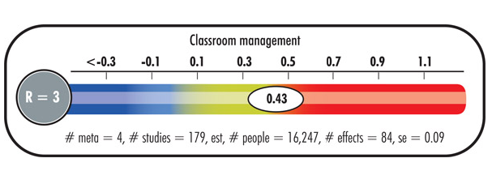
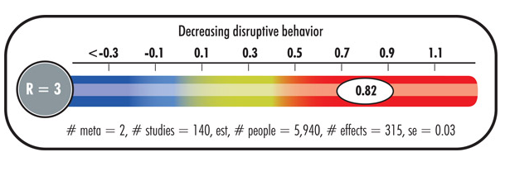

Slide 29
BM Primary School
Number of times students exited from Classrooms
In the 5th year - 40 new students & 5 new staff – 16 ‘exits’.

Slide 30
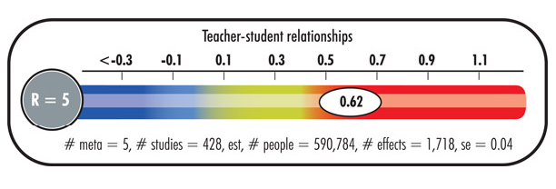

Slide 31
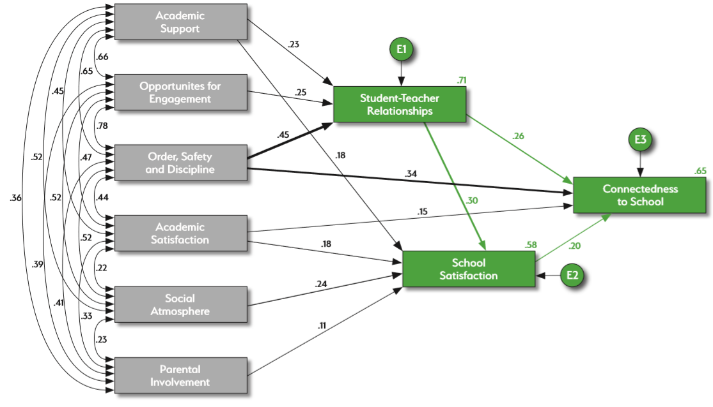

Slide 32
Common identity
Equitable treatment
Psychological Safety
Needed by the group
Ceremonies, rituals & routines

Slide 33
5. The Teacher

Slide 34
Teacher Level Factors

Slide 35
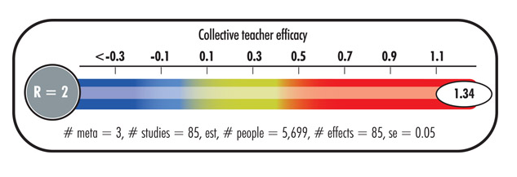

Slide 36
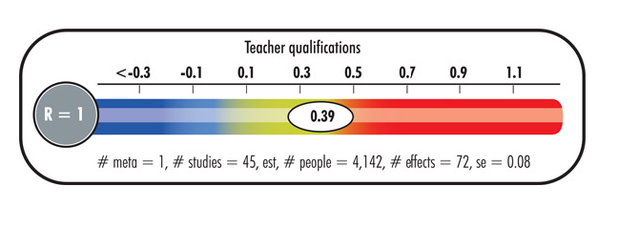
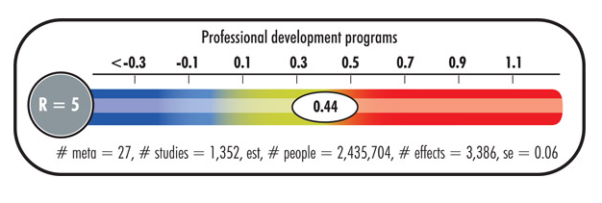

Slide 37
2018-2019
One Adventist School in NSW – 368 participating students
2021-2026
25 schools across the South Pacific Division (K-12)
Australia 6 schools
Fiji 1 schools
New Zealand 7 schools
PNG 6 schools
Samoa 1 school
Solomon Is. 2 schools
Tonga 1 school
Vanuatu 1 school

Slide 38
“Mr ‘Smith’ letting us ask questions and being okay with us having differences.” [Yr 9, Male]
“Open discussions in classes about God and being able to ask questions that wouldn't usually be asked.”
[Yr 10, Female]
“Some teachers will strike up faith based conversations in which they ask for our personal opinions in a genuine manner.” [Yr 11, Male]

Slide 39
6. The Curriculum

Slide 40
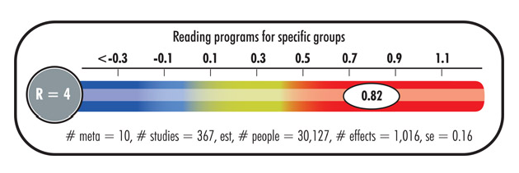
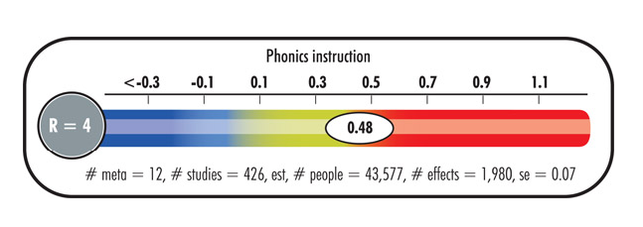

Slide 41
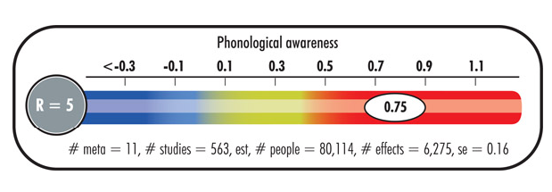

Slide 42
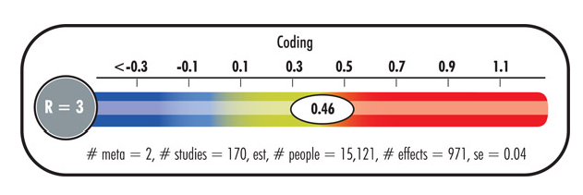
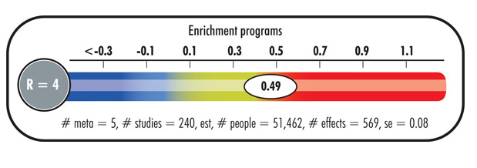

Slide 43
In thinking about how your school positively impacts the development of children/youth, what is one initiative your school has tried that has made a difference?
What initiative/s would your school like to try (or is planning to try)?
What comments or questions do you have about anything we have discussed so far this weekend?

Slide 44
Restore human beings into the image of God as revealed by the life of Jesus Christ.
Foster a balanced development of the whole person—spiritual, physical, intellectual, and social-emotional—a process that spans this world and the next.
Work together with home and church and in cooperation with divine agencies - to prepare learners to be good citizens in this world and in the next.

Slide 45
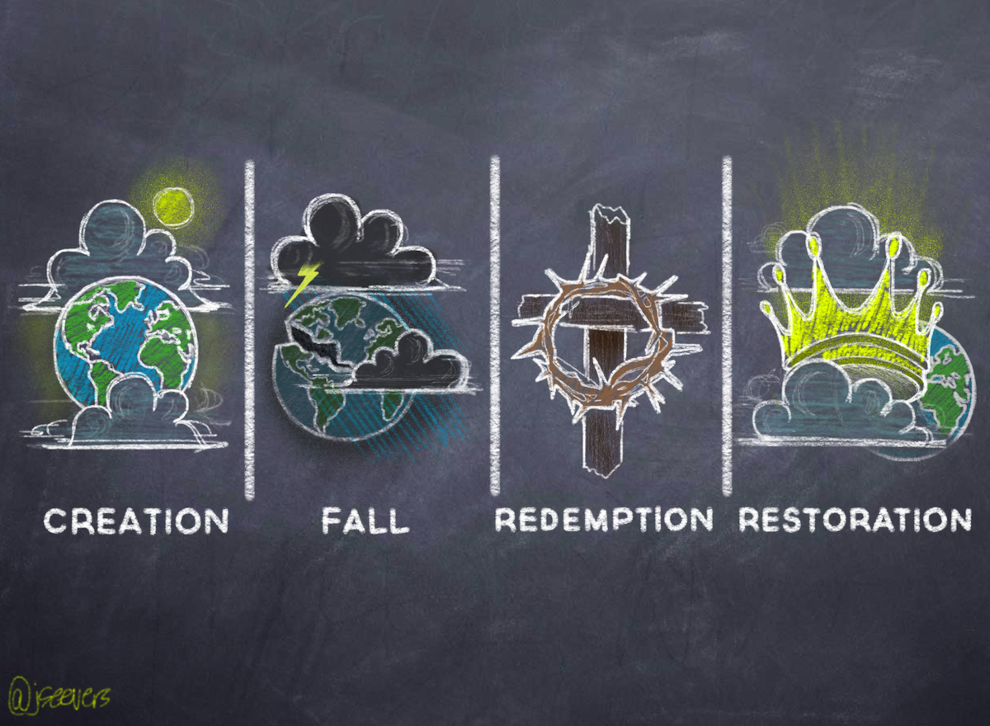
We came into existence by the act of loving God, whom we were created to be in relationship with. God continues to sustain all creation. | Satan aims to discredit God and to destroy His image in creation. The entrance of sin has changed our nature, ideals & values. | God takes the initiative to reveal himself, offering mercy & grace. Divine power is given to restore the imagine of God in the soul. | Christ will return to make all things new. Sin will never again be present in the universe.

Slide 46
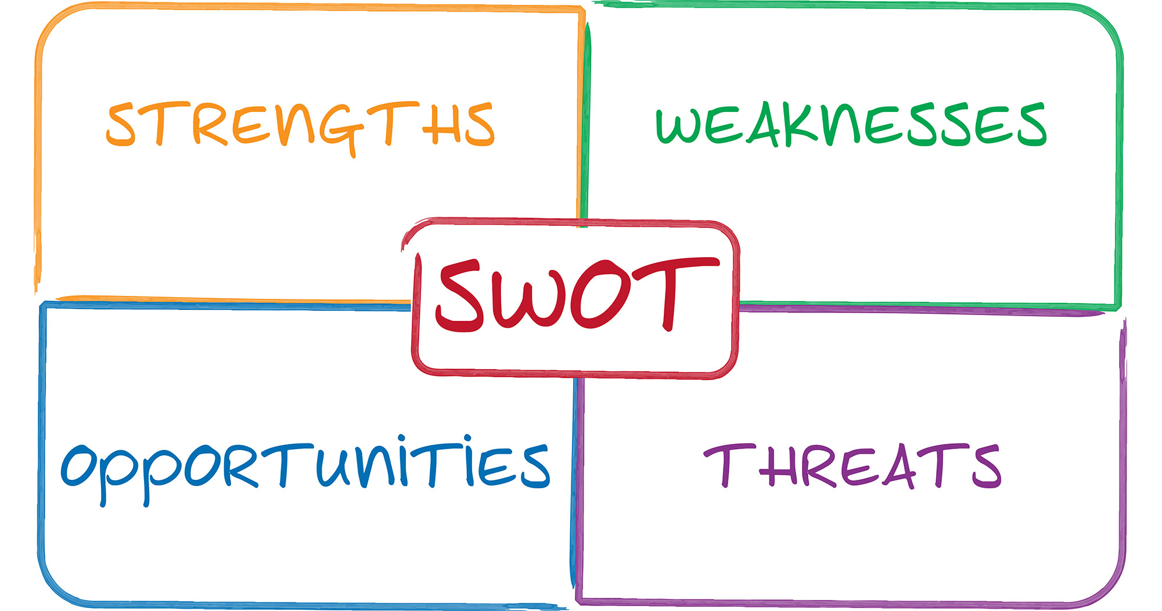
1 Samuel 13:5-6; 15; 19-20; 22
Context Analysis: analysing
the environment in which
an entity operates. E.G. SWOT analysis

Slide 47
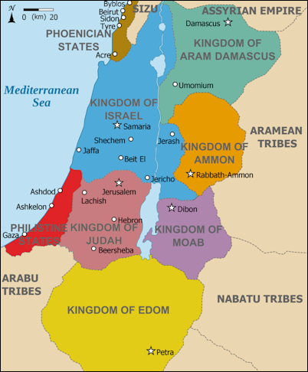
Kingdoms of the Levant in 830 BC
with the Philistine states

Slide 48
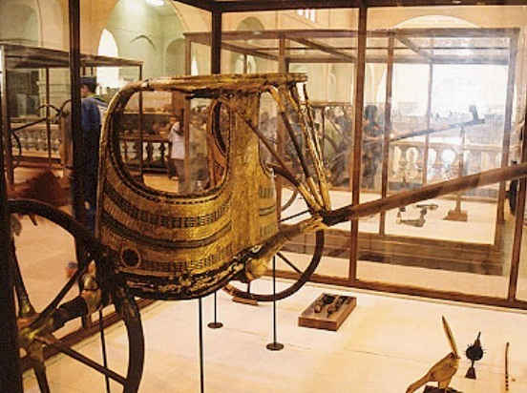

Slide 49
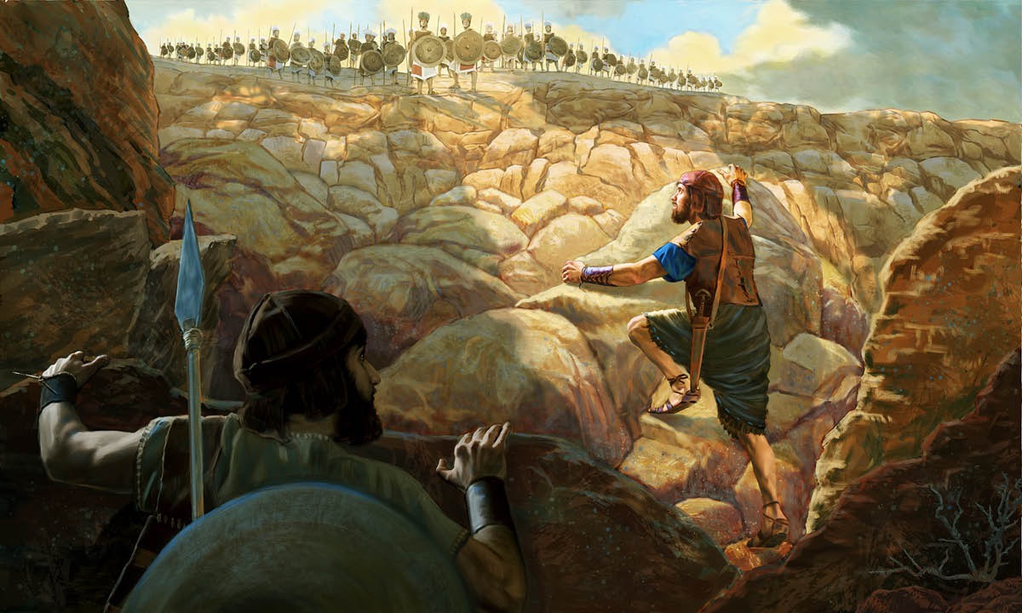
1 Samuel 14: 6-15

Slide 50
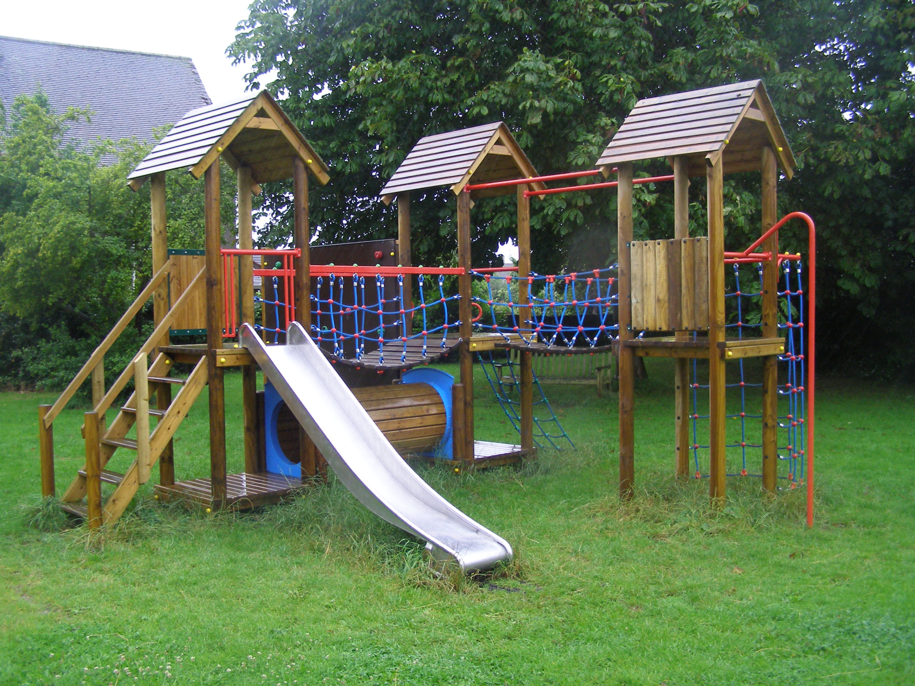

Slide 51
“Our heavenly Father has a thousand ways to provide for us of which we know nothing. Those who accept the one principle of making the service of God supreme will find perplexities vanish and a plain path before their feet.”
MH 281

Slide 52
“Some trust in chariots and some in horses, but we trust in the name of the LORD our God.”
Psalm 20:7

