Slide 1
Growing Amidst the Challenges
Trans-European Division
Quinquennial Education Convention
Hotel Izvor
Serbia
July 26-30, 2023

Slide 2
Exercise and Mental Health
TED Quinquennial Education Convention
Hotel Izvor
Serbia
July 26-30, 2023
Julian Melgosa, PhD, Chartered Psychologist, AFBPsS
Associate Director of Education, SDA World Headquarters

Slide 3
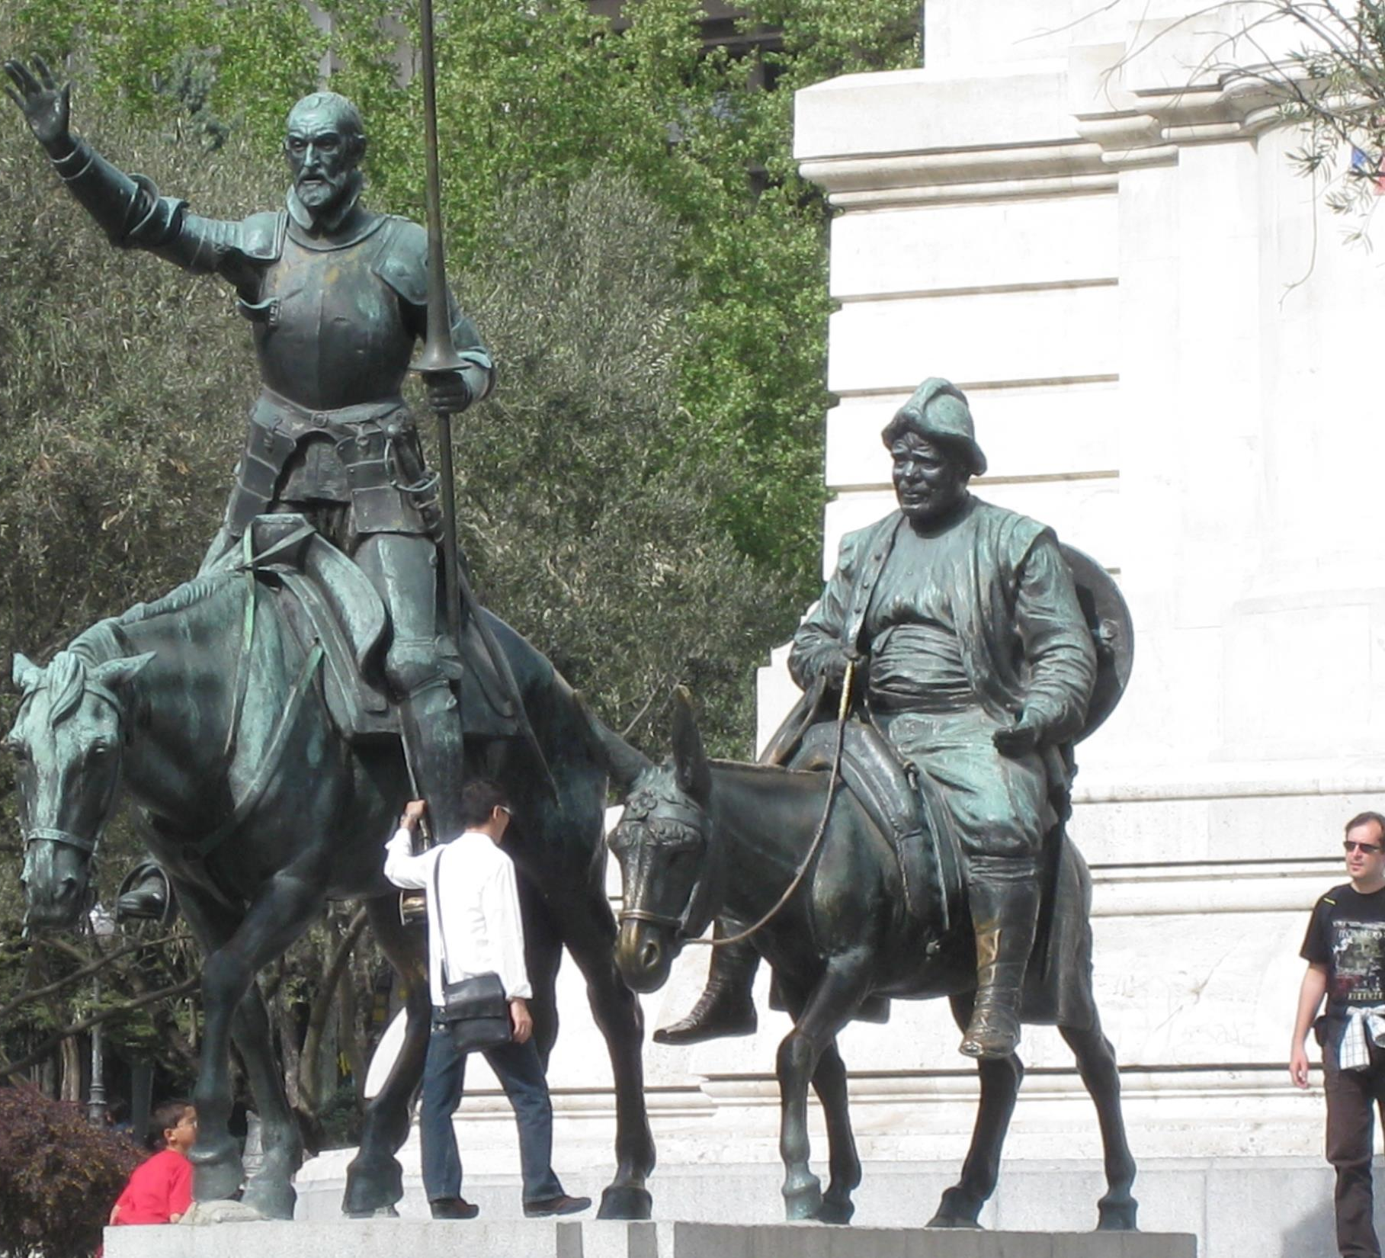
Personal Introduction
I was borne and raised in Madrid, Spain.

Slide 4
Personal Introduction
I have lived and worked for more than five years in each of the following:
Madrid, Spain
Sagunto, Spain
Bracknell, UK
Cavite, Filipinas
Washington, USA
Maryland, USA

Slide 5
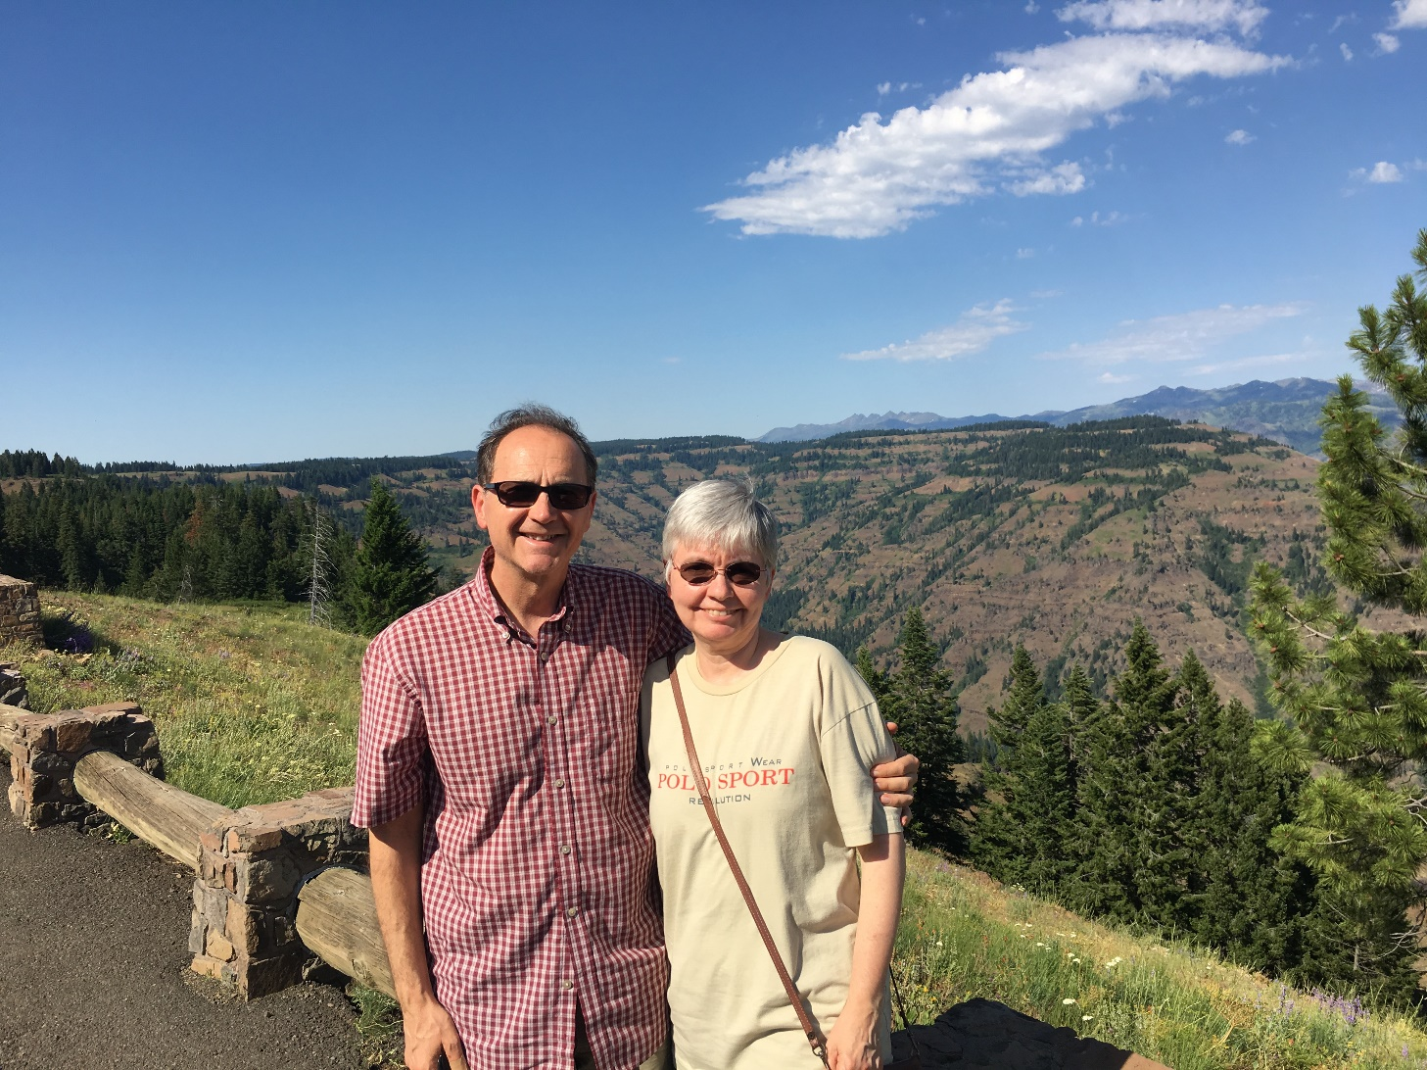
Personal Introduction
Presently, I work at the General Conference of SDA, Silver Spring, Maryland, USA.
I lived with my wife Annette, an academic librarian. We have been married for 40 years.

Slide 6
Claudia and Eric

Slide 7
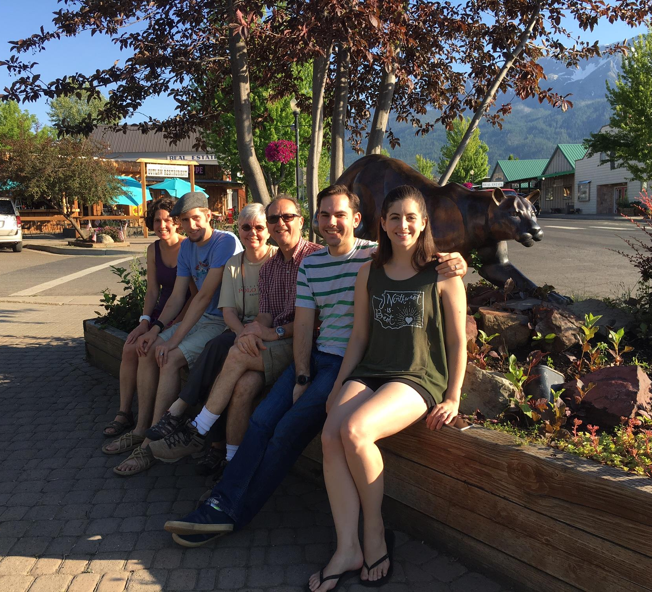
Family Photo

Slide 8
Callie

Slide 9
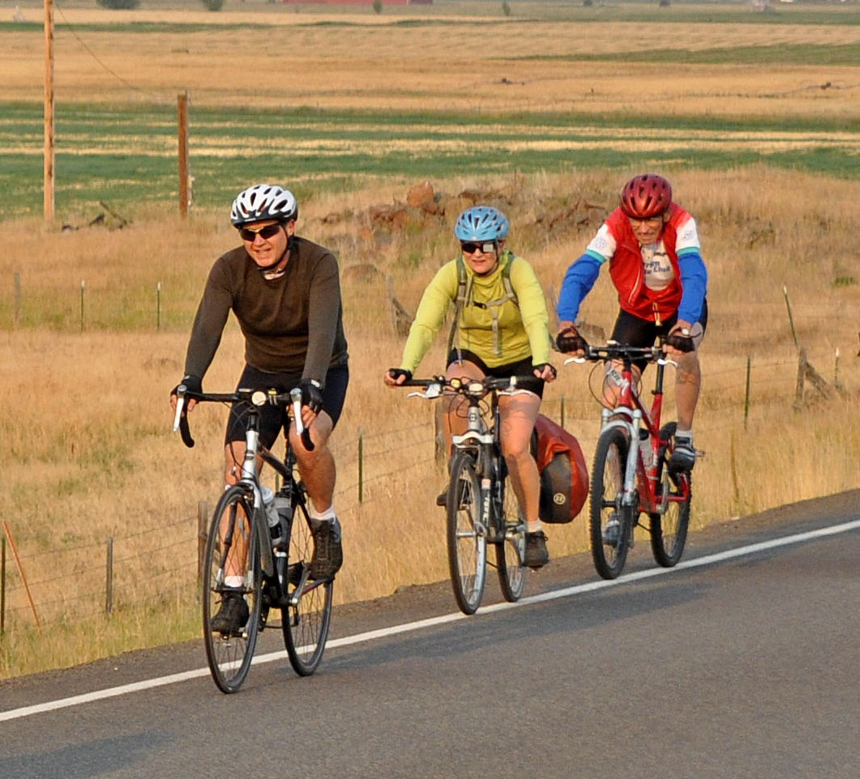
I strive to lead an active lifestyle

Slide 10
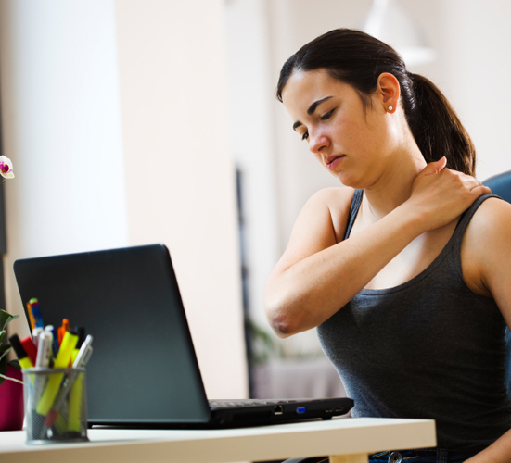
Sedentary Lifestyle
27.5% of adults worldwide (28% men and 34% women) lead a sedentary lifestyle (OMS).
Highest levels: American Continent (40%), Eastern Mediterranean (36%).
High-income countries: 36.8%
Low-income countries: 16.2%

Slide 11
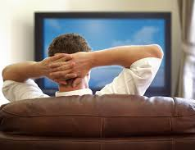
Why inactivity?
Work conditions
Transportation
Leisure style
Electronic devices
Urban life: structural limitations, safety.

Slide 12
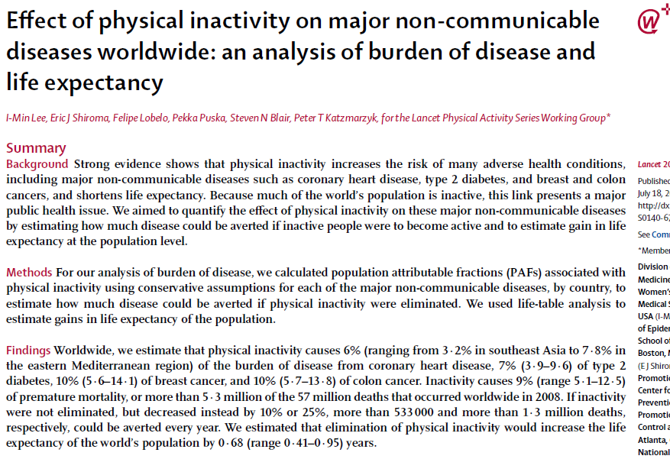
Physical inactivity on major non-communicable diseases

Slide 13
‘Lancet’ Study
Methodology:
Population of Attributable Fractions (PAFs) associated with physical inactivity for each of the major non-communicable diseases.
Conservative Estimates
Results: Sedentary lifestyle…
Increases the risk of many non-communicable diseases, chiefly coronary disease, diabetes type II, breast cancer, and colon cancer.
Reduces life expectancy.
Notes:
PAF is a WHAT IF analysis of what would happen to illness and mortality if the factor were removed (inactivity in this case)

Slide 14
Deaths could be avoided = 1.3 million/year
 | Africa | Americas | Eastern Mediterranean | Europe | Southeast Asia | Western Pacific
Coronary Disease | 15.000 | 60.000 | 44.000 | 121.000 | 59.000 | 100.000
Breast Cancer | 3.000 | 11.000 | 4.000 | 14.000 | 5.000 | 10.000
Colon Cancer | 1.000 | 14.000 | 2.000 | 24.000 | 4.000 | 24.000

Slide 15
Sedentary Lifestyle = Smoking

Slide 16
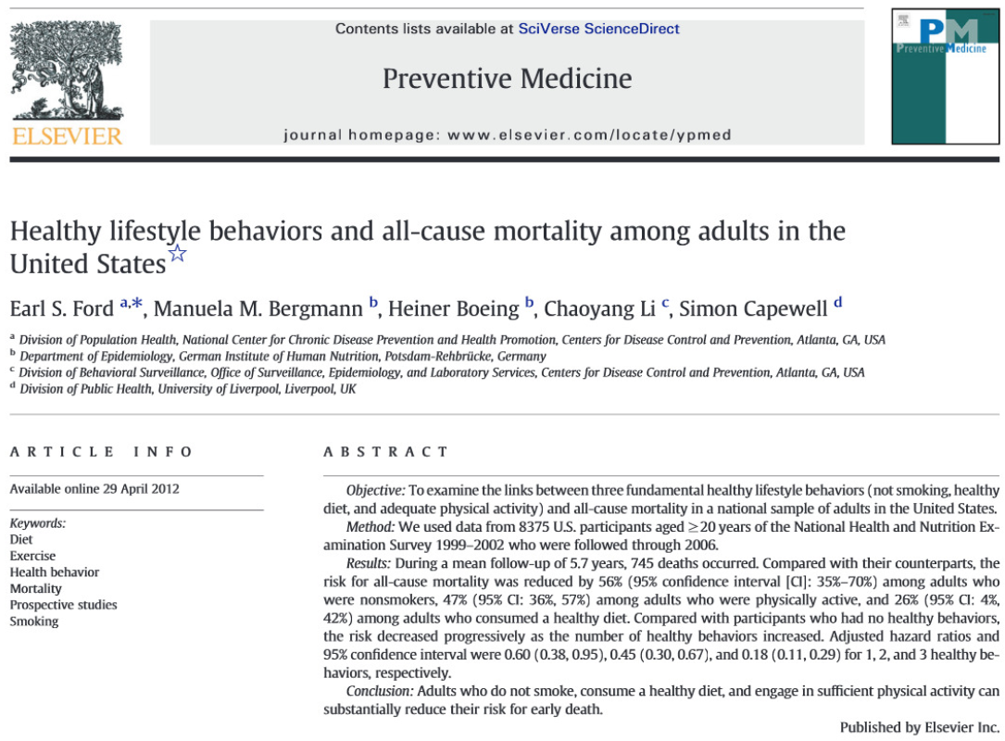
Mortality and Lifestyle

Slide 17
Decreasing mortality (Ford, Bergmann, Boeing, Lee, & Capewell, 2012)
Non smoker, 56%
Active lifestyle, 47% (*)
Healthy diet, 26%
*Criterion: 150 minutes/week, latest 30 days
Notes:
150 minutos o más de actividad moderada o intensa durante los últimos 30 días. Este era el criterio para definir la “vida activa”

Slide 18
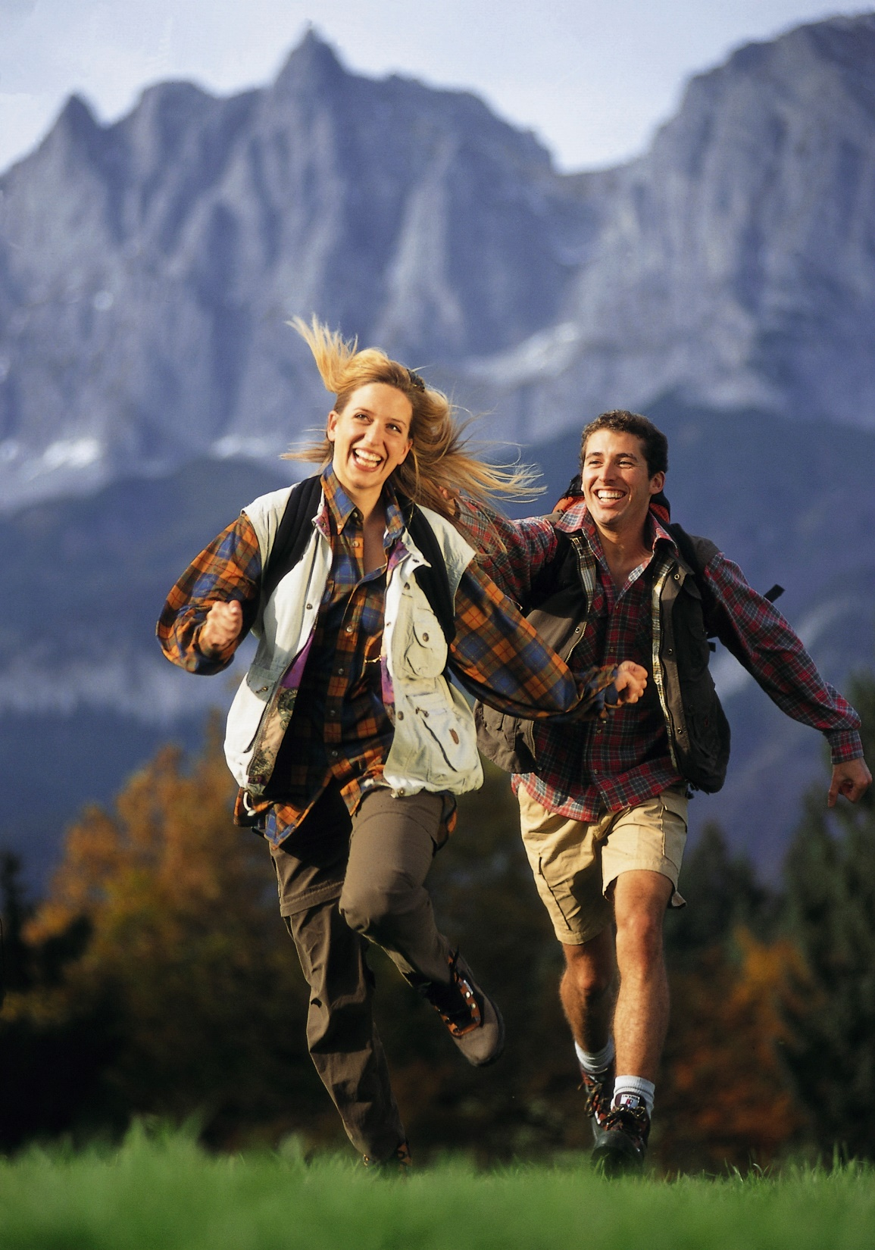
Good reasons to be active
Preserve physical health
Prevent mental illness
Achieve overall wellbeing
Improve looks
Lengthen life expectancy

Slide 19
Reasons/recommendations from WHO
Physical inactivity is the fourth mortality risk factor globally. Six percent of all deaths are due to physical inactivity. It is the leading cause of 21-25% of all colon and breast cancers, of 27% of diabetes cases, and of 30% of ischemic cardiopathy cases.
Regular physical activity helps maintain a healthy body. Active persons have a reduced incidence of the above diseases. They are also less likely to fall and to suffer from hip and vertebrae fractures.

Slide 20
Reasons/recommendations from WHO
Do not confuse physical activity with sports. Simple walks, house chores, gardening, etc. are forms of activity that favor general health.
Physical activity is benign, both vigorously and in moderation. Sophisticated sports may be good, but other general physical activities are also good both when practiced vigorously or in moderation.

Slide 21
Reasons/recommendations from WHO
Los niños y adolescentes (de 5 a 17 años) deberían realizar al menos 60 minutos diarios de actividad física moderada o vigorosa.
Los adultos (de 18 a 64 años) deberían realizar como mínimo 150 minutos semanales de actividad moderada, o 75 minutos de actividad vigorosa, o lo equivalente. Todas las actividades deberían realizarse en periodos de al menos 10 minutos cada uno.

Slide 22
Reasons/recommendations from WHO
Los mayores de 65 años deberían seguir las mismas recomendaciones del grupo anterior, excepto cuando haya problemas de movilidad. Entonces, realizar actividades físicas para mejorar el equilibrio. Los ancianos deberían mantenerse tan activos como les sea posible.
Estas recomendaciones son pertinentes para todo adulto sano, independientes del género, raza, etnia o nivel social, siempre que haya salud. Asimismo, se aplican a las personas con enfermedades crónicas, no transmisibles, no relacionadas con la movilidad, como la hipertensión o la diabetes.

Slide 23
Reasons/recommendations from WHO
Siempre es mejor hacer alguna actividad que ninguna. Las personas inactivas deben comenzar realizando pequeñas cantidades de actividad física, e incrementar gradualmente su duración, frecuencia e intensidad.
Las políticas urbanas y medioambientales tienen un enorme potencial de incrementar la actividad física de la población. Por ejemplo, velar por la accesibilidad y seguridad de la movilidad del peatón y del ciclista, con instalaciones y espacios seguros en torno a los centros escolares.

Slide 24
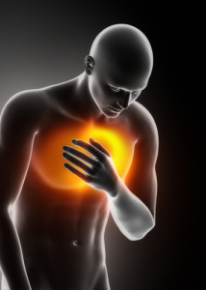
Efecto benigno sobre enfermedades físicas
Cardiopatía
Obesidad
Derrame cerebral
Artrosis
Osteoporosis

Slide 25
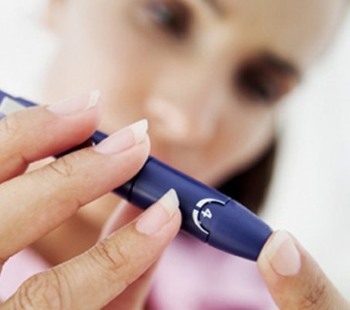
Efecto benigno sobre enfermedades físicas
Diabetes
Colesterol
Cáncer
Cálculo biliar

Slide 26
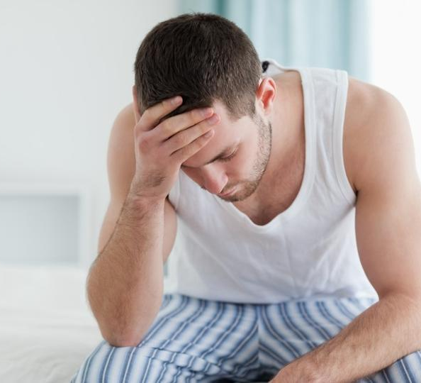
Efecto benigno sobre enfermedades físicas
Demencia senil
Fatiga crónica
Contracturas musculares

Slide 27
Exercise and mental illness

Slide 28
Recent Studies
D’Angelantonio, M., Collins, J. L., Manchia, M., Baldessarini, R. J., & Tondo, L. (2022)
N=2190 Ss from a clinical setting (mood disorder centre)
59% women, 41% men
Assessed for depression, anxiety, PE frequency and intensity.
44.8% major depression, 40.6% bipolar, 14.6% anxiety
Greater PE-frequency was associated with lower ratings of depression (but not anxiety).
Conclusion: Regularly repeated PE again appeared to be beneficial for patients with depression and should be included in their treatment interventions.

Slide 29
Recent Studies
Ji, C., Yang, J., Lin, L., & Chen, S. (2022)
College students assessed for anxiety, all diagnosed with some form of anxiety disorder. Monitored for 6 weeks.
Levels of activity/exercise:
1. Low intensity, low frequency
2. Low intensity, moderate frequency
3. Low intensity, high frequency
4. High intensity, low frequency
5. High intensity, moderate frequency
6. High intensity, high frequency
Results: Both intensity and frequency improved anxiety and decreased symptoms of depression, but intensity did it better than frequency. Intensity improved sleep quality and frequency did not make a difference.
Conclusion: Exercise intensity and exercise frequency have different effects on anxiety, depression and sleep quality improvement.

Slide 30
Recent Studies
Philippot, A., Dubois, V., Lambrechts, K., Grogna, D., Robert, A., Jonckheer, U., Chakib, W., Beine, A., Bleyenheuft, Y., & De Volder, A. G. (2022)
Clinical population of hospitalized adolescents with depression and anxiety.
Experimental design: Random assignment to either PE or no-PE
Experimental group: 3-4 exercise sessions per week for 6 weeks.
Result: Reduction of depression by 3.8 points (significant at 95% level) versus 0.7 points reduction in the control group.
No significant effect in the case of anxiety.
Conclusion: Structured physical exercise add-on therapy integrated into the psychiatric hospitalization of adolescents has led to a reduction in their depressive symptoms, demonstrating its effectiveness in the care of adolescent inpatients with depression.

Slide 31
Funciones cognitivas
El ejercicio físico mejora la actividad mental.
Los niveles de oxígeno, de glucosa, de endorfina y serotonina aumentan durante el ejercicio, produciendo una mejor circulación en los vasos sanguíneos y favoreciendo las funciones cognitivas.
La elevación de la temperatura corporal y la reducción de la tensión muscular producidas por el ejercicio afectan positivamente los procesos mentales.
Diseño típico: dos grupos de participantes realizan una prueba cognitiva. Uno de los grupos practica ejercicio físico intenso durante 20 o 30 minutos. El otro permanece inactivo. Se administra a todos una prueba cognitiva y se evalúan las diferencias.
Resultado típico: los participantes sometidos a ejercicio obtienen resultados superiores en la segunda prueba. Los ‘sin actividad’ obtienen resultados similares.

Slide 32
Funciones cognitivas
Griffin et al. (2011) - Diferencias cognitivas significativas entre dos muestras de jóvenes varones.
Se tomaron muestras de sangre de todos los participantes durante el experimento y se observó que en el grupo sometido a ejercicio habían aumentado los niveles del factor neurotrópico derivado del cerebro (BDNF por sus siglas en inglés, brain-derived neurotrophic factor). Esta proteína BDNF potencia la comunicación neuronal y la memoria, el aprendizaje y el pensamiento complejo de forma sorprendente y el ejercicio físico favorece su secreción.
El factor BDNF es hoy una de las sustancias orgánicas más estudiadas por los científicos.
Notes:
Griffin E. W. et al. Aerobic exercise improves hippocampal function and increases BDNF in the serum of young adult males. Physiological Behavior, 104: 934 – 941 (2011).
Hablar de cuando me que daba atascado a la hora de escribir y no fluía. Me iba de carrera y venía la inspiración

Slide 33
Depression
Physical Activity (PA) brings about euphoria and a sense of wellbeing, partly due to endorphin secretion.
PA increases serotonin, norepinephrine, and dopamine levels—all neurotransmitters that favour psychological wellbeing (this is what psychiatric pharmacology mimics).
PA causes chemical alterations in the hypothalamus-pituitary-adrenal (HPA) axis. PA specifically inhibits secretion of the stress hormones.
Magnetic resonance imaging shows that PA regulates the activity of the pre-frontal cortex causing alleviation of symptoms.

Slide 34
Depression

Slide 35
Depression
Harvey Study:
40,401 Ss residents of Norway
Ex post facto study
Questionnaire on exercise and activity, quantity, quality, intensity during free time.
Mental health assessment, including depression
Results: Inverse correlation: between physical activity and depressive symptoms.

Slide 36
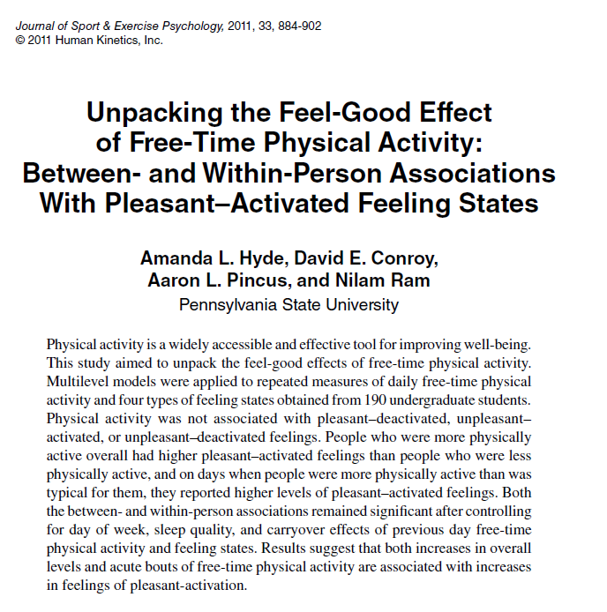
Exercise and pleasant feeling states

Slide 37
Exercise and pleasant feeling states
Hyde Study:
190 university students
Daily habits during leisure time
Mental Health Tests
Results:
Physically active – sig. higher level of pleasant feelings—the feel-good effect of exercise (the runner’s high).
Physically active – better social interaction (external wellbeing)

Slide 38
Anxiety
According to several studies…
Any person who leads a systematically active lifestyle have a reduced risk of 25% to suffer from anxiety when compared with sedentary persons.
These days many psychotherapies are recommending physical exercise in addition to counselling in their treatment plans.

Slide 39
Anxiety
How does physical activity help people experiencing anxiety?
PE channels pent up energy out of the organism.
Anxious persons experience heart beat, sweat, etc and they learn that symptoms are not necessarily associated with panic attack.
Workouts stimulate tryptophan secretion. Tryptophan is an essential amino acid that elevates serotonin levels. Both of these chemicals provide physical and psychological wellbeing.
PE favours the secretion of gamma-aminobutyric acid (GABA), the principal neurotransmitter that inhibits anxiety. This is the way anxiolytic medicine works.

Slide 40
Anxiety
Canadian study (Blacklock et al., 2010) performed a trial with 50 women, 25 of them breast cancer survivors; the remaining 25 without diagnosis.
Physical exercise (20 min pedalling, moderate and intense)
Anxiety assessed: tests before and after the intervention.
Both groups significantly lowered their level of anxiety.
Notes:
-------------------------
Blacklock, R. et al. Effects of exercise intensity and self-efficacy on state anxiety with breast cancer survivors. Oncology Nursing Forum, 37: 206 – 212 (2010).

Slide 41
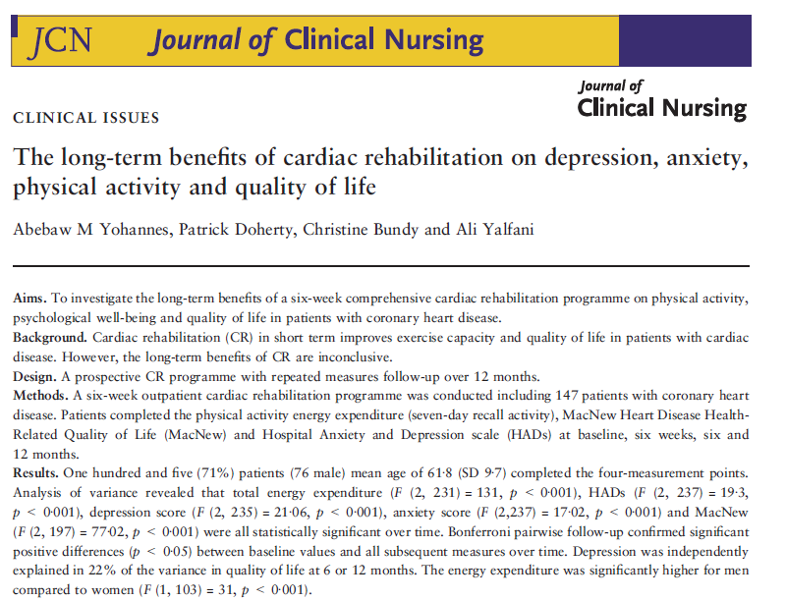
For how long does it last?
Notes:
LONG-TERM EFFECT

Slide 42
Anxiety
Yohannes Study:
Cardiac patients (N=147), average age = 61.8
6-week exercise programme
Assessment of anxiety (and depression)…
At the end of programme
6 months later
12 months later
Anxiety and depression reduced significantly after the programme.
Benefits continued to be present at 6 and at 12 months

Slide 43
Stress
Stress Mechanism
Stress causes a notable organic commotion
The adrenal glands secrete hormones (norepinephrine, adrenalin, epinephrine, cortisol…). They cause palpitations, high blood pressure, rapid breathing, sweat, etc.…
The amygdala stimulates the hippocampus (memory centre), which in interaction with the cerebral cortex decides on the magnitude of the organic alarm that is necessary to face the threat.
What does exercise do?
Physical exercise lets the raised energy (due to the fight-or-flight reaction) out and the state of alarm ceases.

Slide 44
Stress
How else does exercise help?
PE pumps people’s endorphins (the runner’s high)
Achieves balance in the adrenal activity, making the production and secretion adaptable and with the right amount of stress.
Exercise facilitates the production of norepinephrine, calming the stress response and improving the communication between systems: cardiovascular, respiratory, renal and musculoskeletal.
The deep breathing caused by exercise favours a relaxing organic response.

Slide 45
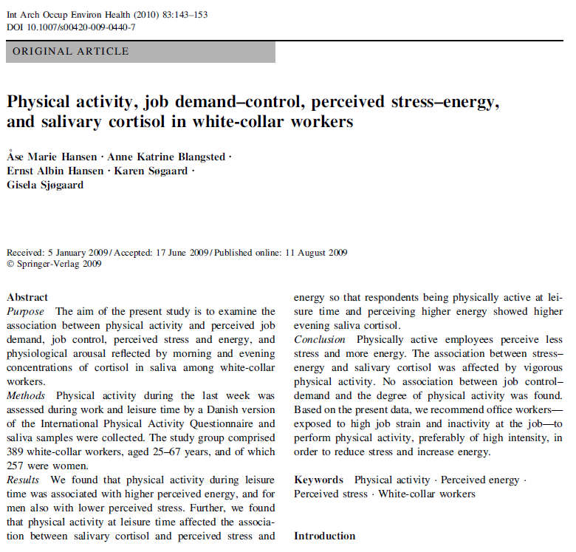
Stress
Notes:
Danish Population

Slide 46
Stress
Hansen’s Study:
Participants: N=389 sedentary Danish, healthy men and women, all white-collar workers
All physical exercise was recorded. An objective measure in saliva: Cortisol to assess stress
When exercise was present, cortisol levels were minimal and the higher the amount of exercise, the lower the stress levels and the higher the feelings of energy.
Authors conclude with the recommendation that sedentary employees carry out physical activity, preferably of high intensity in order to reduce stress and increase perceived sense of energy.
Notes:
Hansen, Å. M. et al. Physical activity, job demand-control, perceived stress-energy, and salivary cortisol in white-collar workers. International Archives of Occupational and Environmental Health, 83: 143 – 153 (2010).

Slide 47
Autoestima Enojo y agresividad Adicciones Anorexia Bulimia Función sexual Carencia de dominio propio

Slide 48
Physical Health Benefits
Weight loss + Metabolic index - Risk of coronary disease Strengthening of cardiac muscle - heart beats at rest - blood pressure - cholesterol + oxygen in blood + respiratory function + lung capacity Alleviates asthma symptoms Improves digestion Regulates intestinal movements Prevents the development of kidney stones | - riesgo diabetes tipo 2 - riesgo síndrome metabólico Alivia el dolor menstrual Regulador hormonal Favorece la gestación - fatiga crónica Fortalece la estructura ósea + equilibrio corporal - dolor de espalda + la función articular + fuerza muscular + reacción muscular Relaja el sistema muscular Alivia efectos de varices Favorece la recuperación de las contracturas Alivia el dolor de cabeza | - riesgo de accidente cerebral - riesgo de artrosis - riesgo de oteoporosis + eliminación de toxinas + previene el desarrollo de cáncer Elimina las impurezas cutáneas Previene la inflamación Mejora la apariencia física Fortalece el sistema inmunitario Previene la demencia - riesgo de caída en los mayores + longevidad

Slide 49
Exercise and mental health
Improves mood Adds energy Improves job performance Regulates sleep Whets appetite Prevents and alleviates depression Prevents and alleviates anxiety Improves self-confidence Increases memory Strengthens mental functions Improves alertness Reduces stress Reduces worry Fights boredom Improves self-esteem | Expands pain threshold Enhances concentration Strengthen sexual function Inhibits anger Channels aggressiveness Helps strengthen self-discipline Helps the fight against addictions Helps overcome bulimia Helps overcome anorexia Increases enthusiasm Promotes positive thinking Helps overcome shyness Helps overcome tragedies Contributes to discover one’s abilities Increases productivity

Slide 50
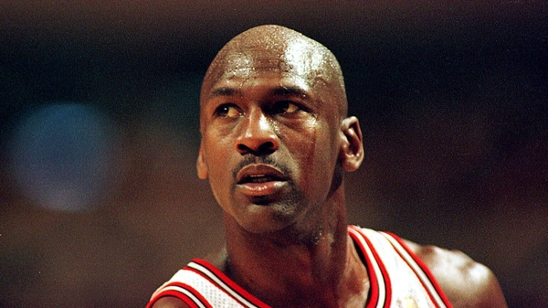
Facing barriers
“Obstacles don’t have to stop you. If you run into a wall, don’t turn around and give up. Figure out how to climb it, go through it, or work around it.”
(Michael Jordan)

Slide 51
Barriers that prevent activity
Lack of time, being busy
Lack of training
Cost of gear, gym, transportation
Weather
The look of others (feeling of shyness)
Mess of exercise

Slide 52
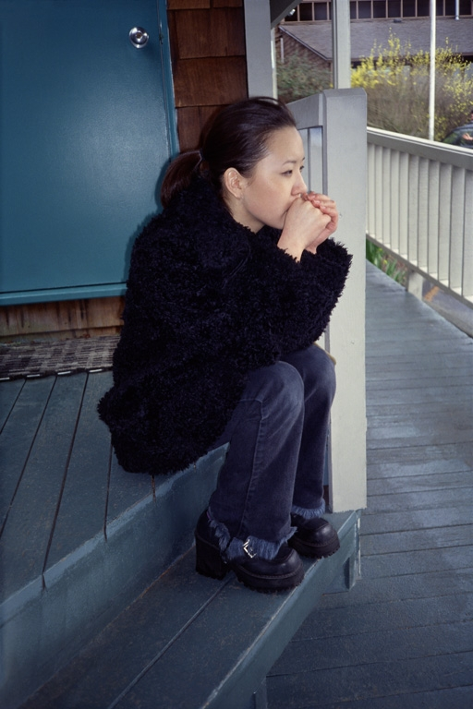
By pairs: How to face these barriers?
Lack of time, being busy
Lack of training
Cost of gear, gym, transportation
Weather
The look of others (feeling of shyness)
Mess of exercise

Slide 53
Social environment Group activity
What are the advantages and disadvantages of physical exercise practiced alone?
What are the advantages and disadvantages of physical exercise practiced in pairs or in group?

Slide 54
How can one persevere?
Sep up goals
Use rewards as motivation
Keep records
Regularity
Electronic devices
Exercise with friends/family
Music

